Slide 1
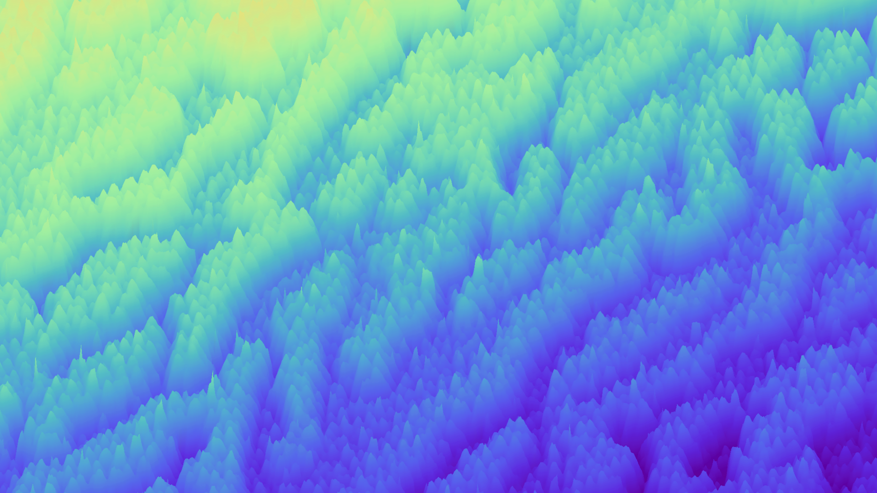
PLD Plasma Propagation Model
Based on a model by Tom Wijnands
Adapted by Sam Borkent

Slide 2
Introduction
Model description
Approximations and assumptions
What did I do and why?
Results
Conclusions
Suggestions
Let’s discuss

Slide 3
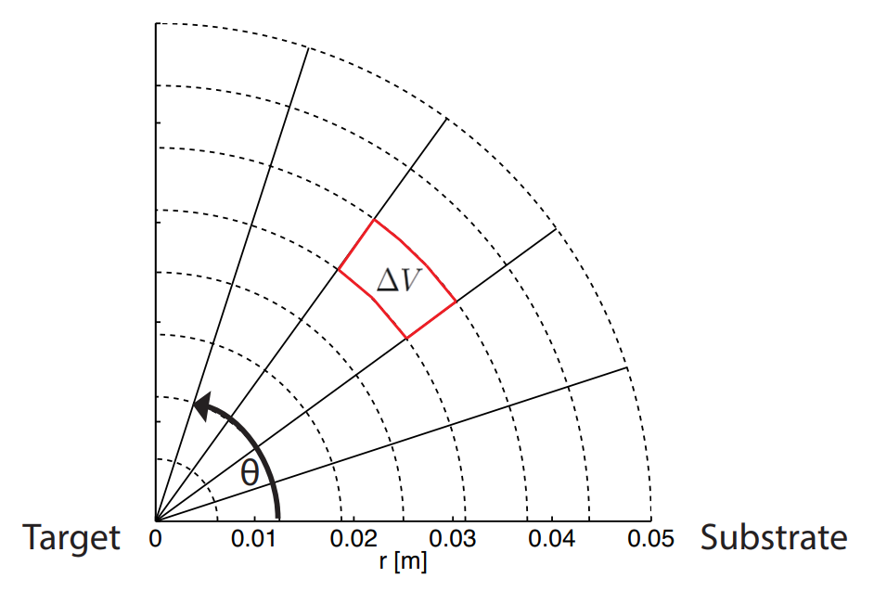
Model description
Divide space into computational bins
Determine the number of ablated particles per laser pulse
Calculate the initial velocity of particles immediately after ablation
Determine the number of background gas particles based on the deposition pressure
Collect the plasma and background particles into their designated computational bin
Perform a 1D collision calculation problem for every angle
Combine 1D results to achieve a 2D propagation model
Number of collisions
Particle
type
Velocity

Slide 4

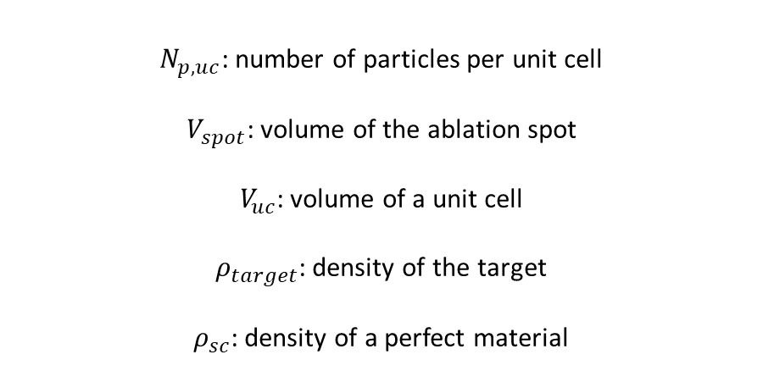
Model description
Divide space into computational bins
Determine the number of ablated particles per laser pulse
Calculate the initial velocity of particles immediately after ablation
Determine the number of background gas particles based on the deposition pressure
Collect the plasma and background particles into their designated computational bin
Perform a 1D collision calculation problem for every angle
Combine 1D results to achieve a 2D propagation model
$$N_{p, tot}=N_{p,uc}\frac{V_{spot}}{V_{uc}}\frac{ρ_{target}}{ρ_{sc}}$$
$N_{p,uc}$: number of particles per unit cell
$V_{spot}$: volume of the ablation spot
$V_{uc}$: volume of a unit cell
$ρ_{target}$: density of the target
$ρ_{sc}$: density of a perfect material

Slide 5
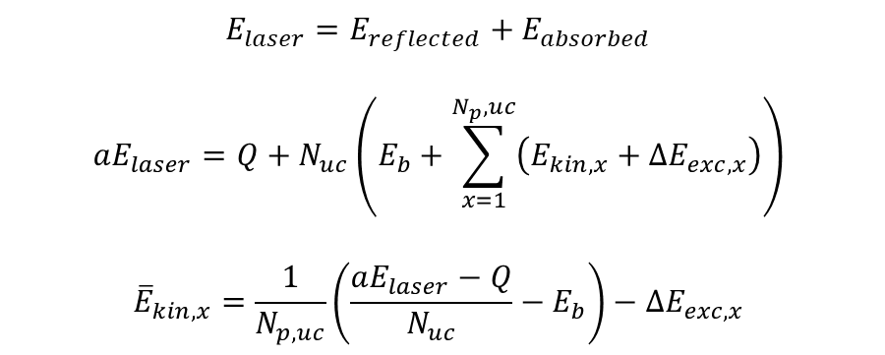
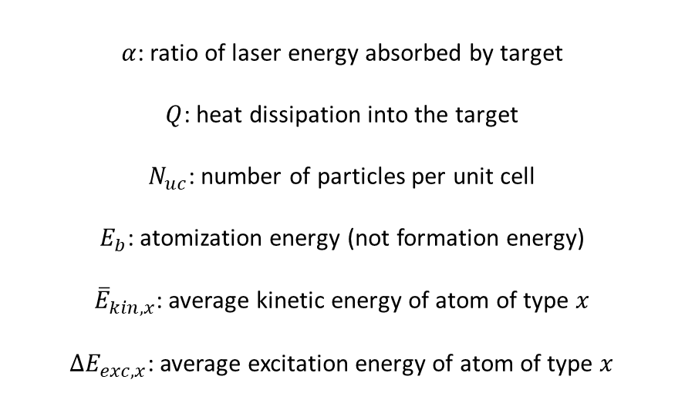
Model description
Divide space into computational bins
Determine the number of ablated particles per laser pulse
Calculate the initial velocity of particles immediately after ablation
Determine the number of background gas particles based on the deposition pressure
Collect the plasma and background particles into their designated computational bin
Perform a 1D collision calculation problem for every angle
Combine 1D results to achieve a 2D propagation model
$$E_{laser}=E_{reflected}+E_{absorbed}$$
$$aE_{laser}=Q+N_{uc}\left(E_{b}+\sum_{x=1}^{N_{p},uc}{\left(E_{kin,x}+{ΔE}_{exc,x}\right)}\right)$$
$${\overline{E}}_{kin,x}=\frac{1}{N_{p,uc}}\left(\frac{aE_{laser}−Q}{N_{uc}}−E_{b}\right)−{ΔE}_{exc,x}$$
$α$: ratio of laser energy absorbed by target
$Q$: heat dissipation into the target
$N_{uc}$: number of particles per unit cell
$E_{b}$: atomization energy (not formation energy)
${\overline{E}}_{kin,x}$: average kinetic energy of atom of type $x$
$ΔE_{exc,x}$: average excitation energy of atom of type $x$

Slide 6
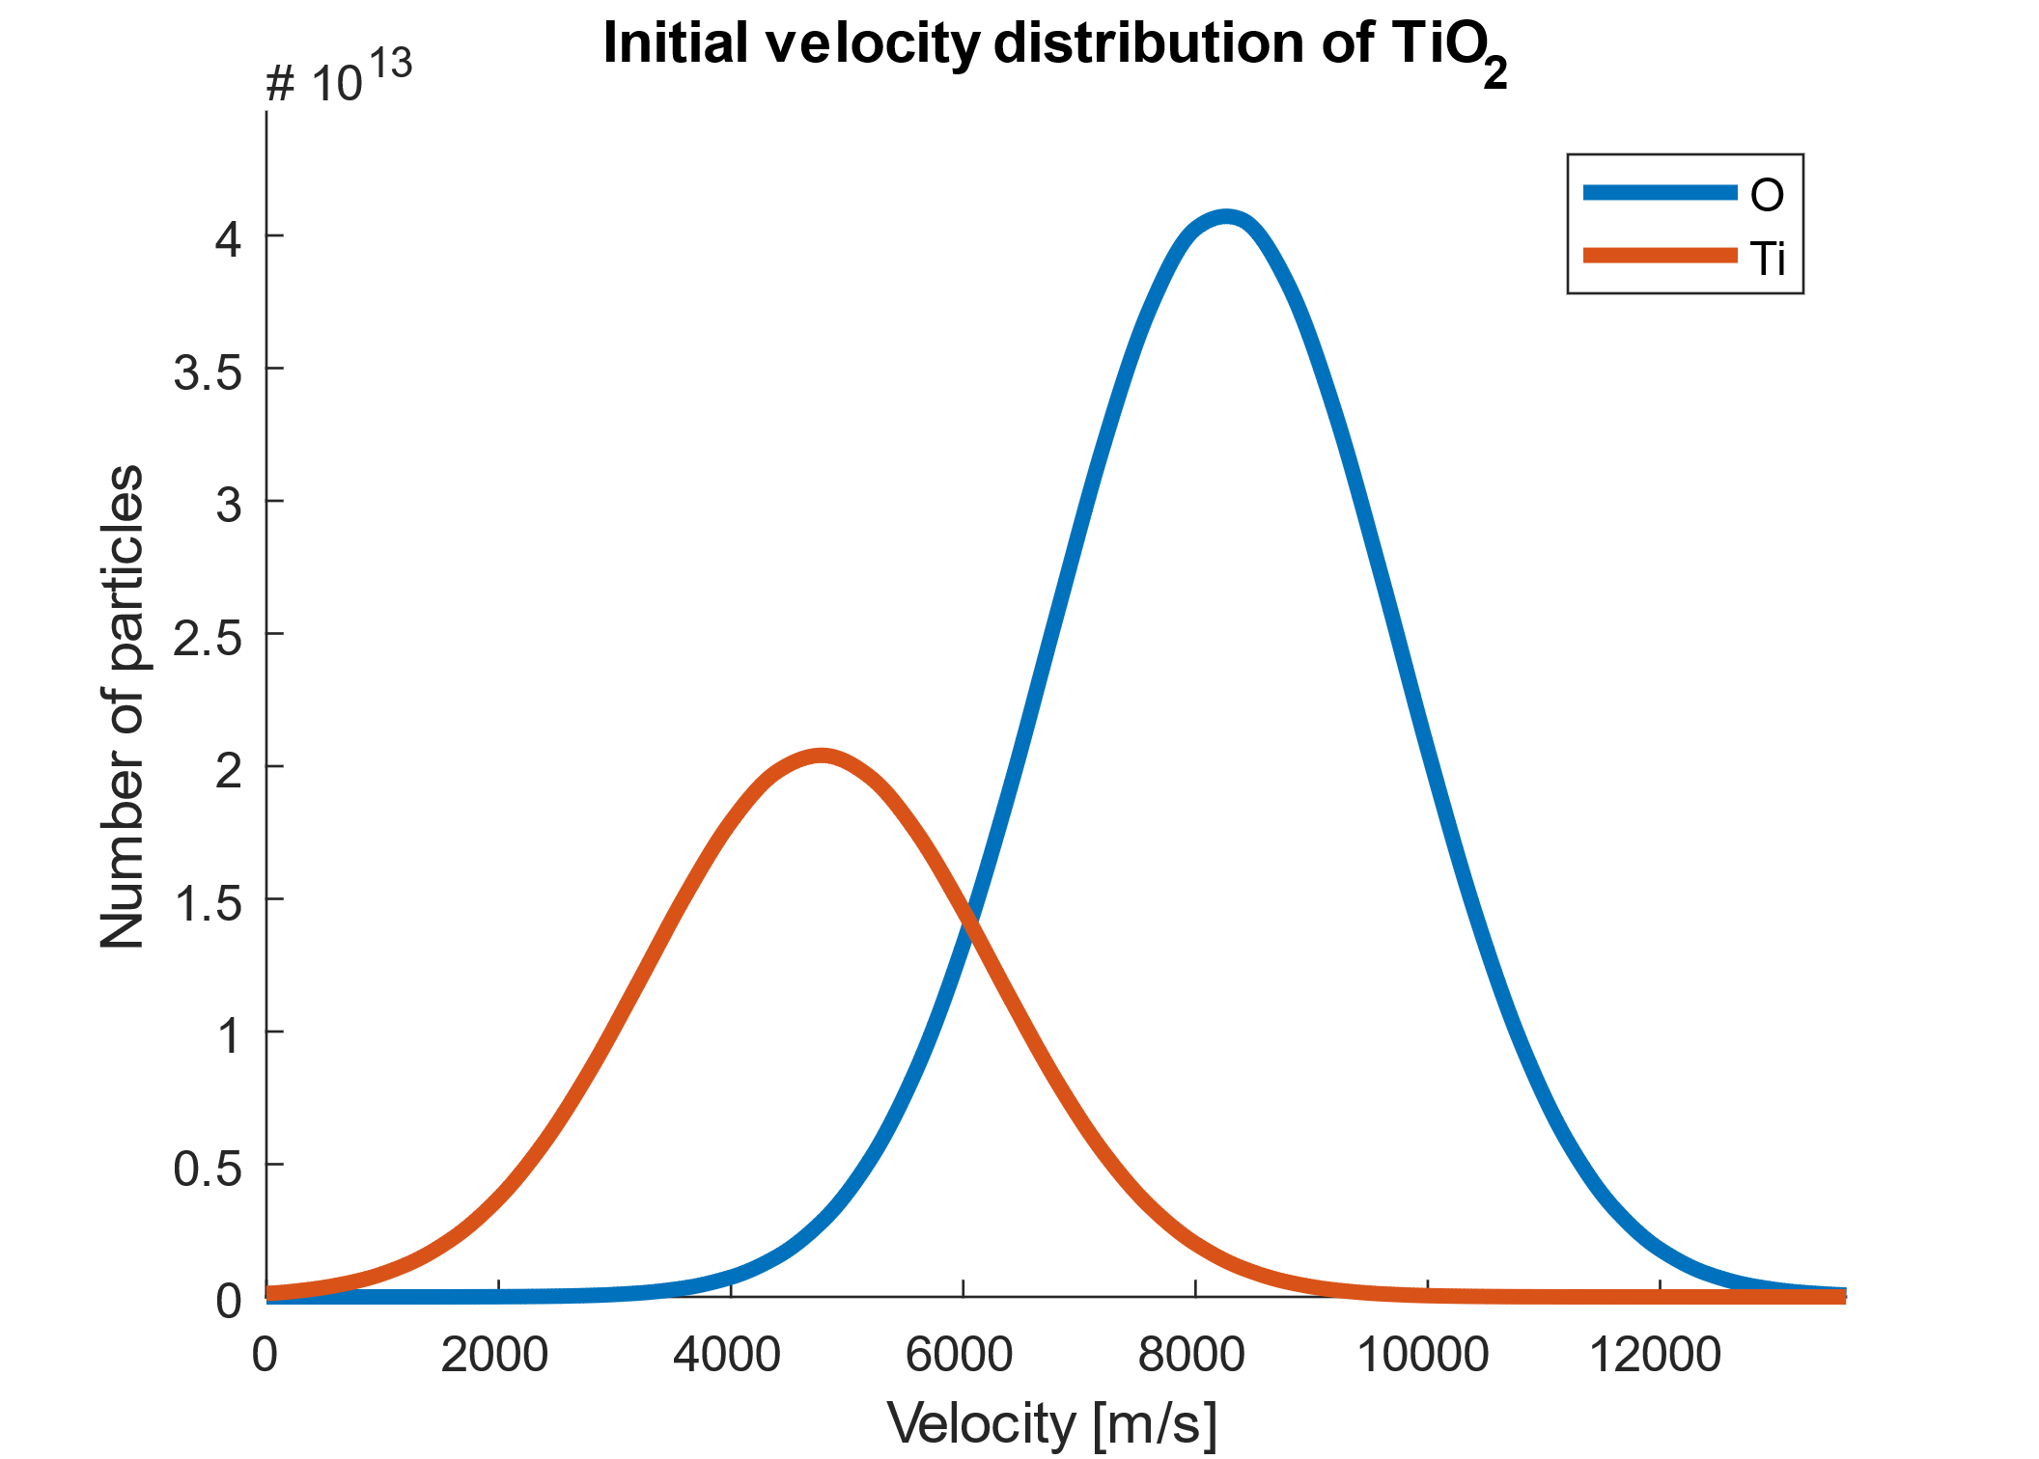
Model description
Divide space into computational bins
Determine the number of ablated particles per laser pulse
Calculate the initial velocity of particles immediately after ablation
Determine the number of background gas particles based on the deposition pressure
Collect the plasma and background particles into their designated computational bin
Perform a 1D collision calculation problem for every angle
Combine 1D results to achieve a 2D propagation model
Normal distribution

Slide 7
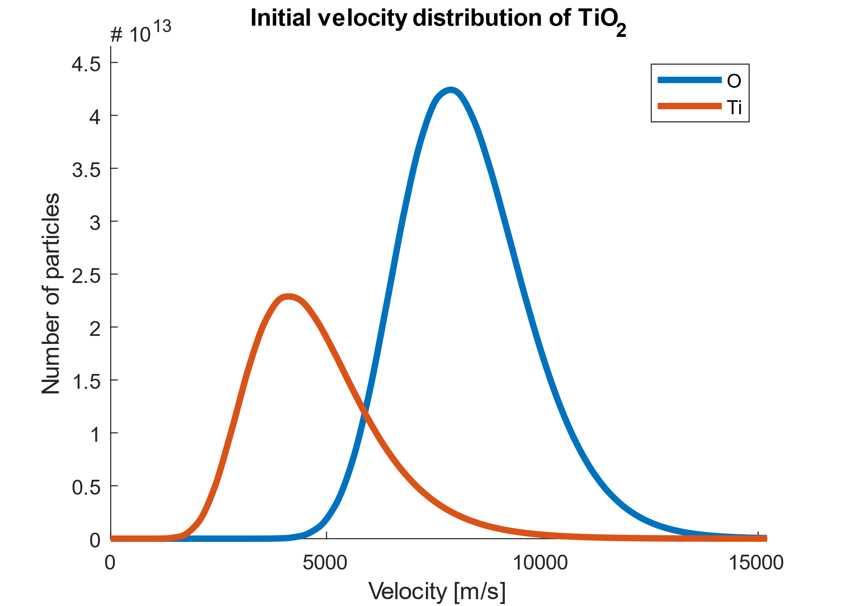
Model description
Divide space into computational bins
Determine the number of ablated particles per laser pulse
Calculate the initial velocity of particles immediately after ablation
Determine the number of background gas particles based on the deposition pressure
Collect the plasma and background particles into their designated computational bin
Perform a 1D collision calculation problem for every angle
Combine 1D results to achieve a 2D propagation model
Log-normal distribution

Slide 8
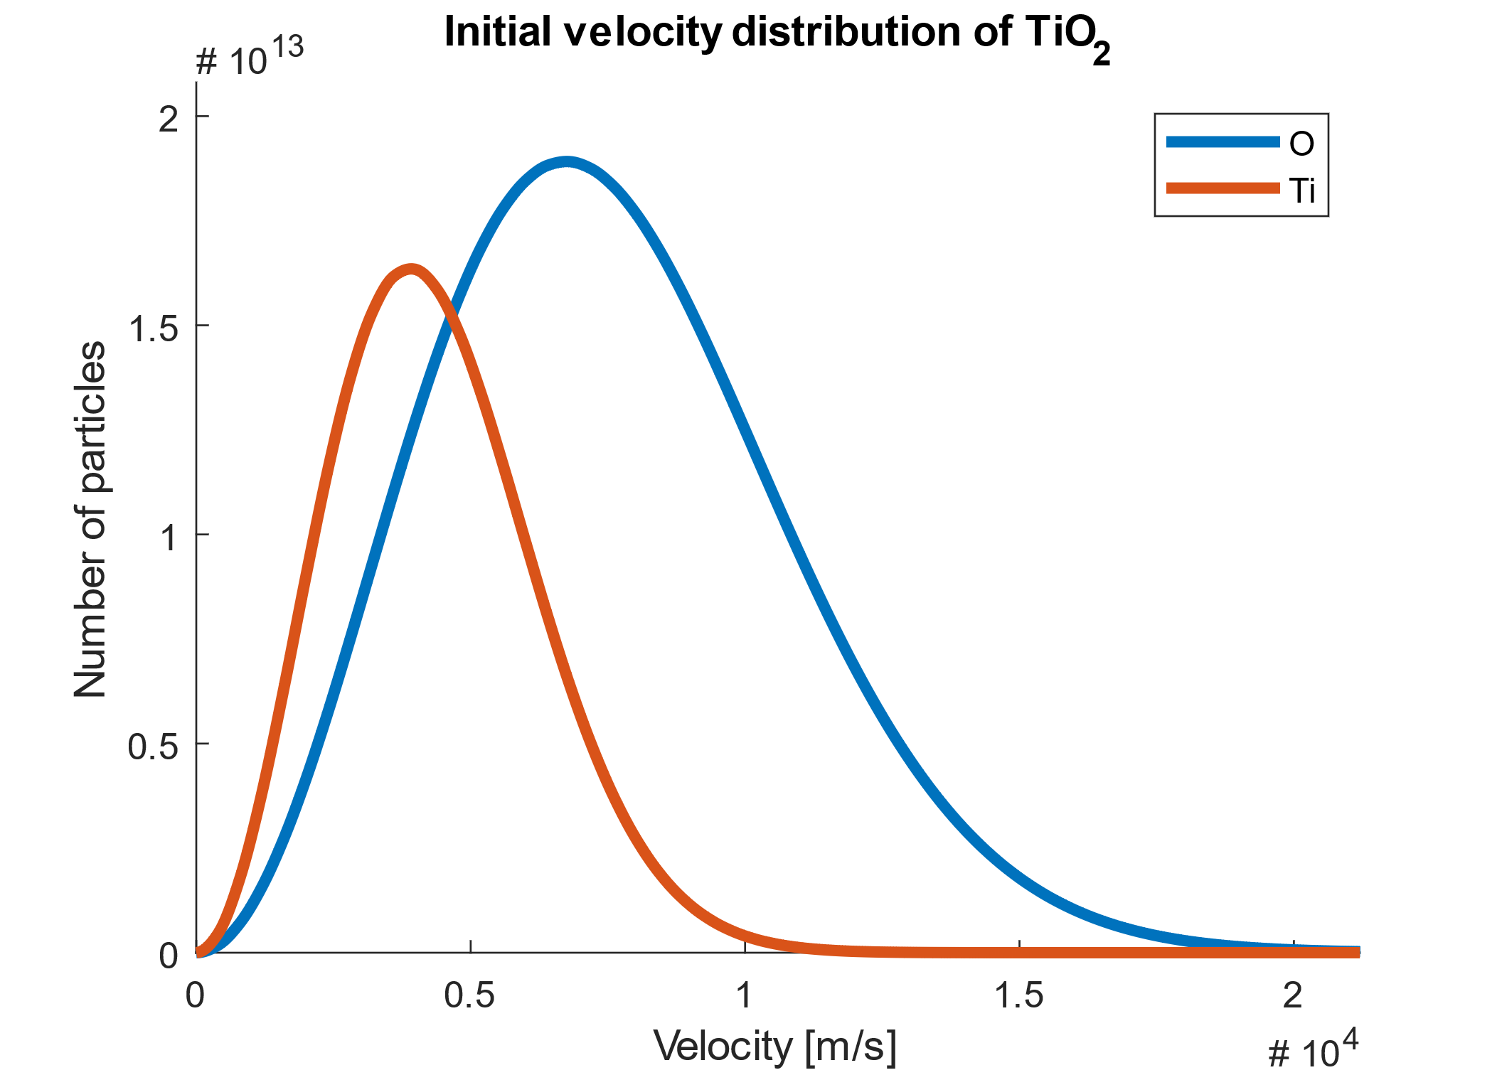
Model description
Divide space into computational bins
Determine the number of ablated particles per laser pulse
Calculate the initial velocity of particles immediately after ablation
Determine the number of background gas particles based on the deposition pressure
Collect the plasma and background particles into their designated computational bin
Perform a 1D collision calculation problem for every angle
Combine 1D results to achieve a 2D propagation model
Maxwell-Boltzmann distribution

Slide 9
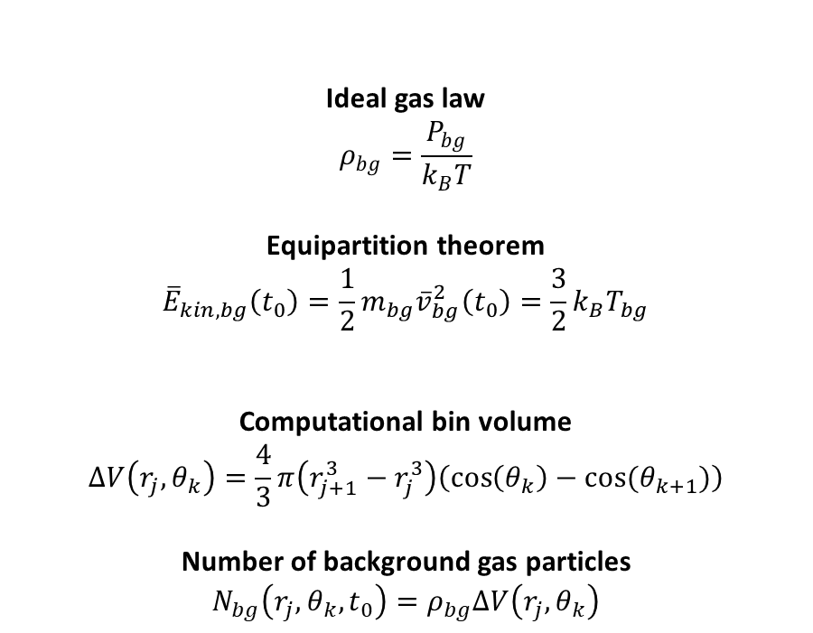
Model description
Divide space into computational bins
Determine the number of ablated particles per laser pulse
Calculate the initial velocity of particles immediately after ablation
Determine the number of background gas particles based on the deposition pressure
Collect the plasma and background particles into their designated computational bin
Perform a 1D collision calculation problem for every angle
Combine 1D results to achieve a 2D propagation model
Ideal gas law
$$ρ_{bg}=\frac{P_{bg}}{k_{B}T}$$
Equipartition theorem
$${\overline{E}}_{kin,bg}\left(t_{0}\right)=\frac{1}{2}m_{bg}{\overline{v}}_{bg}^{2}\left(t_{0}\right)=\frac{3}{2}k_{B}T_{bg}$$
Computational bin volume
$$ΔV\left(r_{j},θ_{k}\right)=\frac{4}{3}π\left(r_{j+1}^{3}−r_{j}^{3}\right)\left(\cos\left(θ_{k}\right)−\cos{(θ_{k+1})}\right)$$
Number of background gas particles
$$N_{bg}\left(r_{j},θ_{k},t_{0}\right)=ρ_{bg}ΔV\left(r_{j},θ_{k}\right)$$

Slide 10
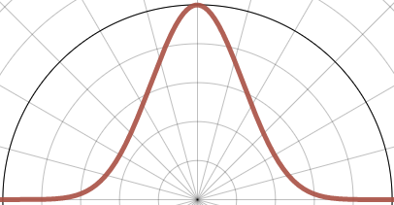
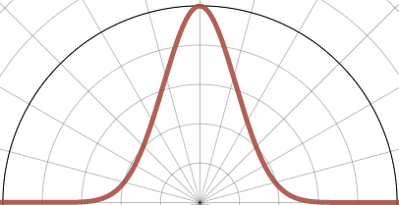
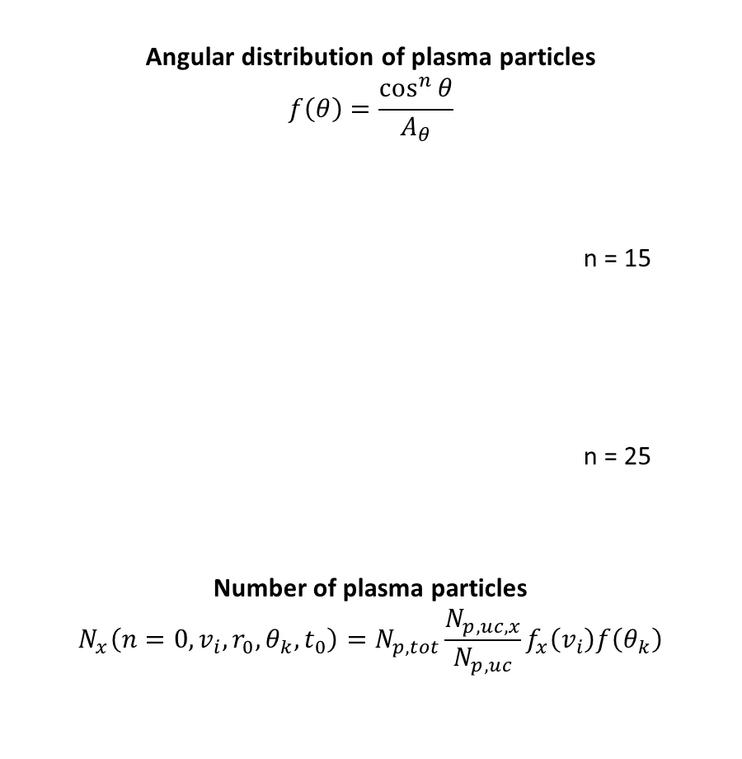
Model description
Divide space into computational bins
Determine the number of ablated particles per laser pulse
Calculate the initial velocity of particles immediately after ablation
Determine the number of background gas particles based on the deposition pressure
Collect the plasma and background particles into their designated computational bins
Perform a 1D collision calculation problem for every angle
Combine 1D results to achieve a 2D propagation model
Angular distribution of plasma particles
$$f\left(θ\right)=\frac{\cos^{n}{θ}}{A_{θ}}$$
n = 15
n = 25
Number of plasma particles
$$N_{x}\left(n=0,v_{i},r_{0}, θ_{k},t_{0}\right)=N_{p,tot}\frac{N_{p,uc,x}}{N_{p,uc}}f_{x}\left(v_{i}\right)f\left(θ_{k}\right)$$

Slide 11
Model description
Divide space into computational bins
Determine the number of ablated particles per laser pulse
Calculate the initial velocity of particles immediately after ablation
Determine the number of background gas particles based on the deposition pressure
Collect the plasma and background particles into their designated computational bin
Perform a 1D collision calculation problem for every angle
Combine 1D results to achieve a 2D propagation model
Collision categories
Elastic collisions between particle of the same type
Elastic collisions between the plasma and background
Reactive collisions between the plasma and background
Elastic collisions between metals in the plasma
Collisions between metals and oxygen in the plasma

Slide 12
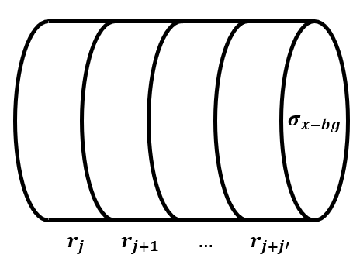
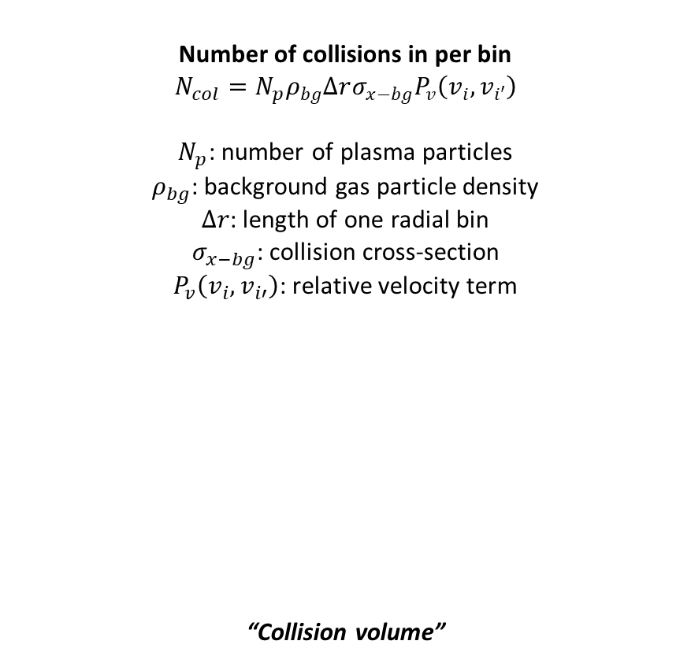
Model description
Divide space into computational bins
Determine the number of ablated particles per laser pulse
Calculate the initial velocity of particles immediately after ablation
Determine the number of background gas particles based on the deposition pressure
Collect the plasma and background particles into their designated computational bin
Perform a 1D collision calculation problem for every angle
Combine 1D results to achieve a 2D propagation model
Number of collisions in per bin
$$N_{col}=N_{p}ρ_{bg}Δrσ_{x−bg}P_{v}\left(v_{i},v_{i′}\right)$$
$N_{p}$: number of plasma particles
$ρ_{bg}$: background gas particle density
$Δr$: length of one radial bin
$σ_{x−bg}$: collision cross-section
$P_{v}\left(v_{i},v_{i′}\right)$: relative velocity term
“Collision volume”

Slide 13
Model description
Divide space into computational bins
Determine the number of ablated particles per laser pulse
Calculate the initial velocity of particles immediately after ablation
Determine the number of background gas particles based on the deposition pressure
Collect the plasma and background particles into their designated computational bin
Perform a 1D collision calculation problem for every angle
Combine 1D results to achieve a 2D propagation model
Collision calculation steps
Loop through all radial bins
Loop through all velocity bins
Store the number of plasma particles in this bin
Calculate the projected traveled path of the particles in one time step in case of no collisions
Loop through all radial bins within the projected path
Loop through all velocity bins that are filled with background particles, that move slower than the plasma particles
Calculate the number of collided particles
Calculate the new velocity and position of particles after collision
Remove the collided particles from their velocity and radial bins prior to collision
Update the position of non-collided particles
Add back the collided particles to their new velocity and position

Slide 14
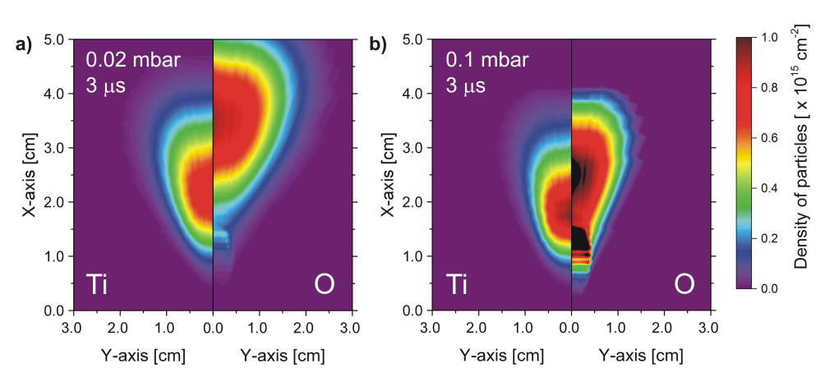
Model description
Divide space into computational bins
Determine the number of ablated particles per laser pulse
Calculate the initial velocity of particles immediately after ablation
Determine the number of background gas particles based on the deposition pressure
Collect the plasma and background particles into their designated computational bin
Perform a 1D collision calculation problem for every angle
Combine 1D results to achieve a 2D propagation model

Slide 15
Approximations and assumptions
There is no net exchange of particles between angular bins
All particles move along a straight line following their initial angle
Background gas particles initially have a constant temperature (no heat gradient)
Background gas particles initially have no preferential propagation direction, so a net zero velocity
Square laser ablation spot, resulting in an axially symmetric plasma expansion
Heat dissipation into the target and excitation energy of atoms during ablation can be neglected
All collisions are head-on and fully elastic
Collisions only occur between plasma particles and background gas particles

Slide 16
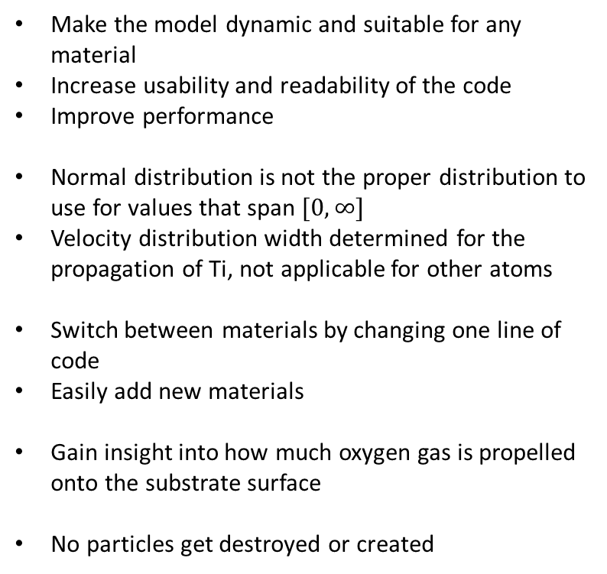
What did I do?
Why did I do it?
Redesigned the code from the ground up
Reimplemented the initial velocity distribution
Implemented support for any target composition
Fully model background gas particle kinematics
Ensured conservation of number of particles, kinetic energy, and momentum
Make the model dynamic and suitable for any material
Increase usability and readability of the code
Improve performance
Normal distribution is not the proper distribution to use for values that span $[0, ∞]$
Velocity distribution width determined for the propagation of Ti, not applicable for other atoms
Switch between materials by changing one line of code
Easily add new materials
Gain insight into how much oxygen gas is propelled onto the substrate surface
No particles get destroyed or created

Slide 17
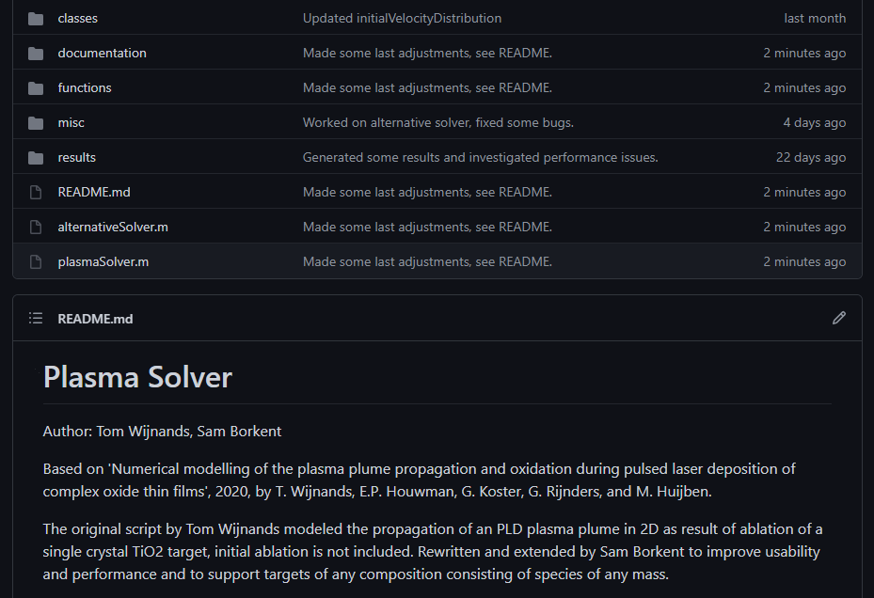
GitHub (private)

Slide 18
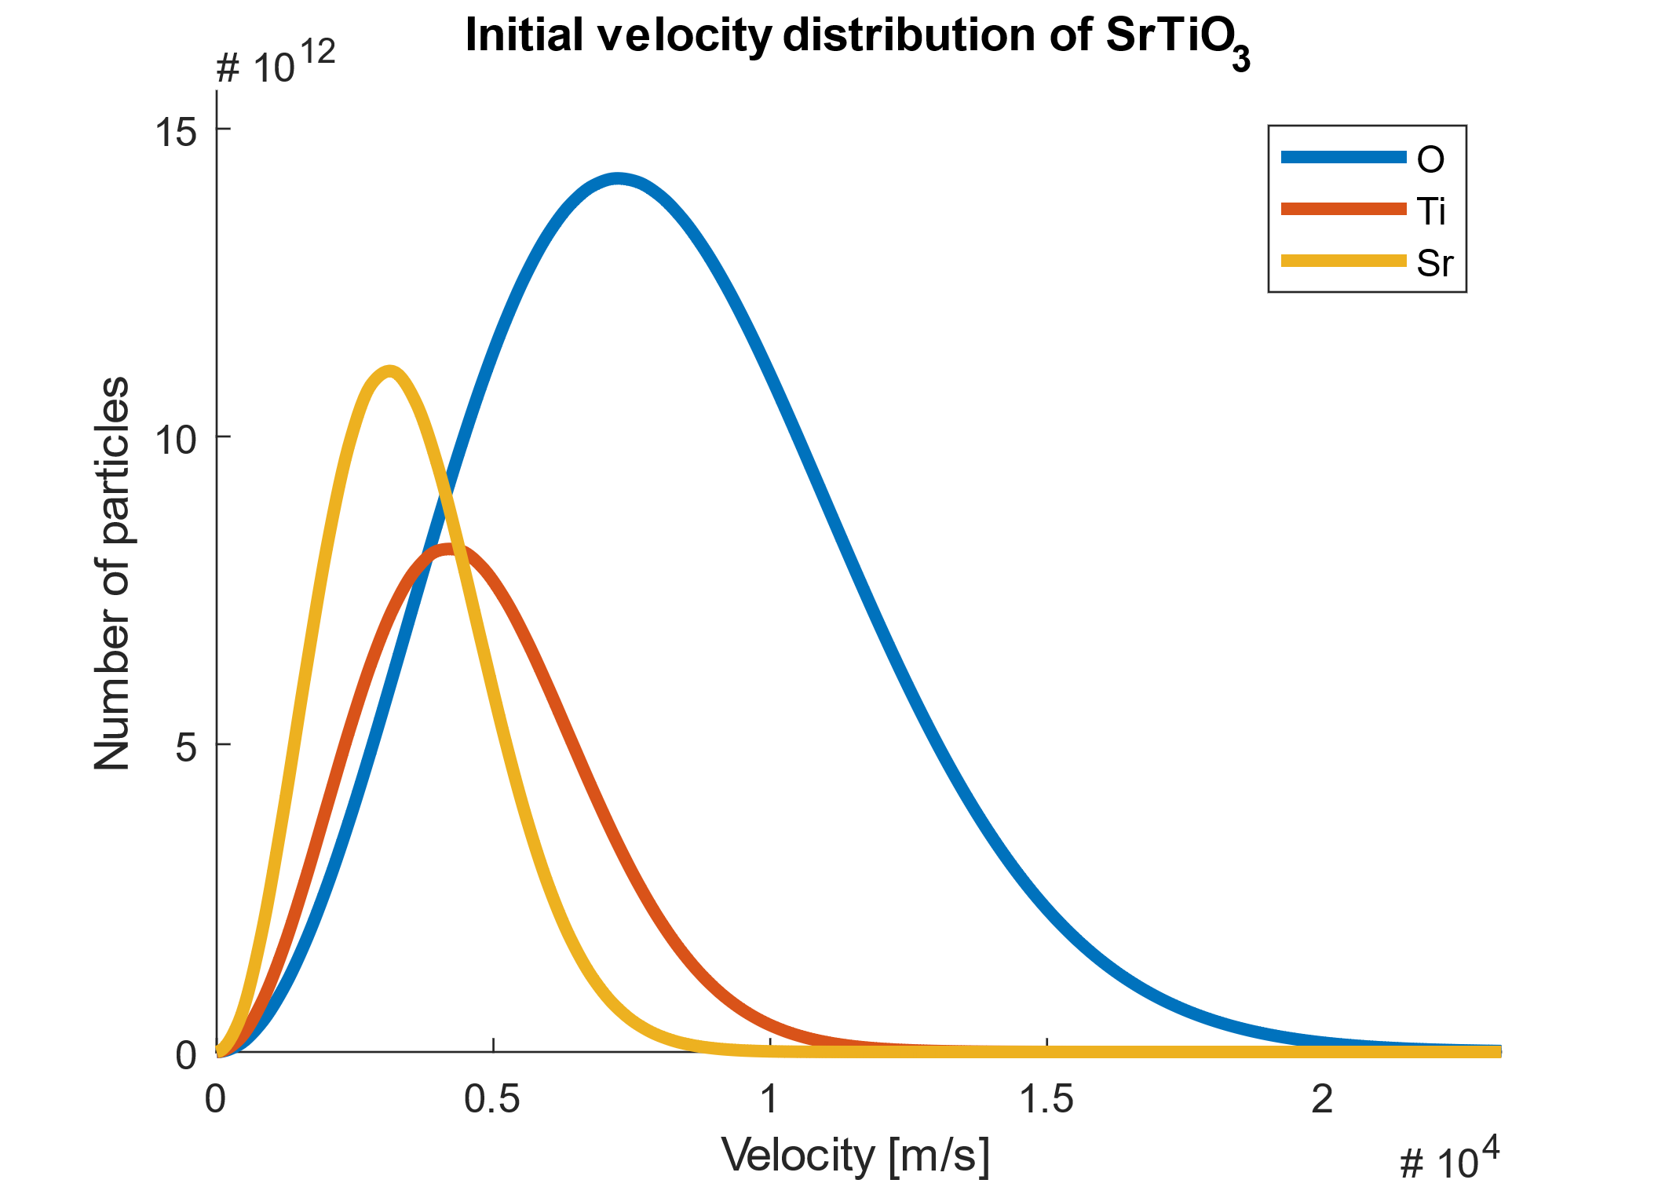
Results Initial velocity distribution

Slide 19
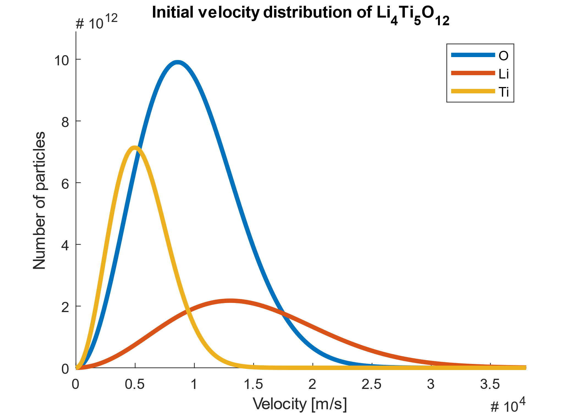
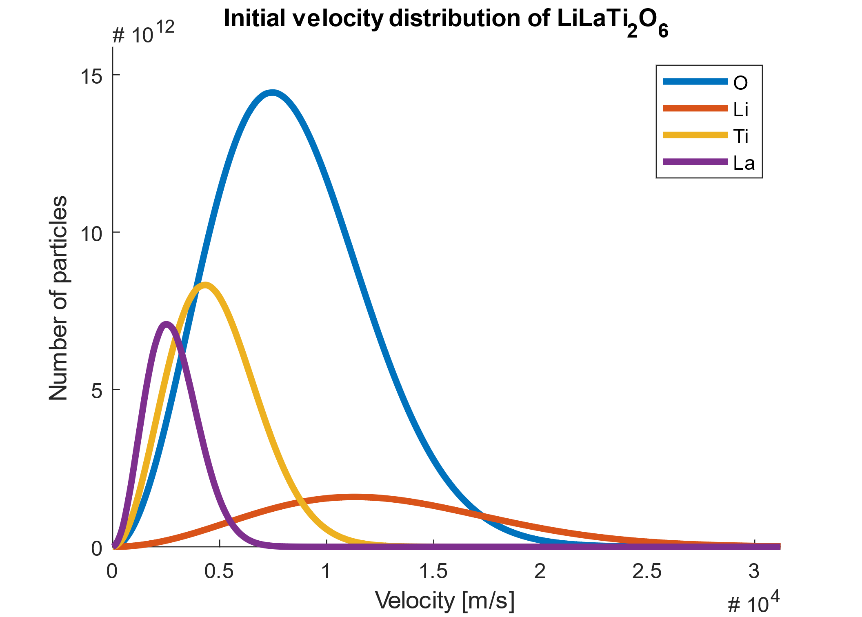
Results Initial velocity distribution

Slide 20
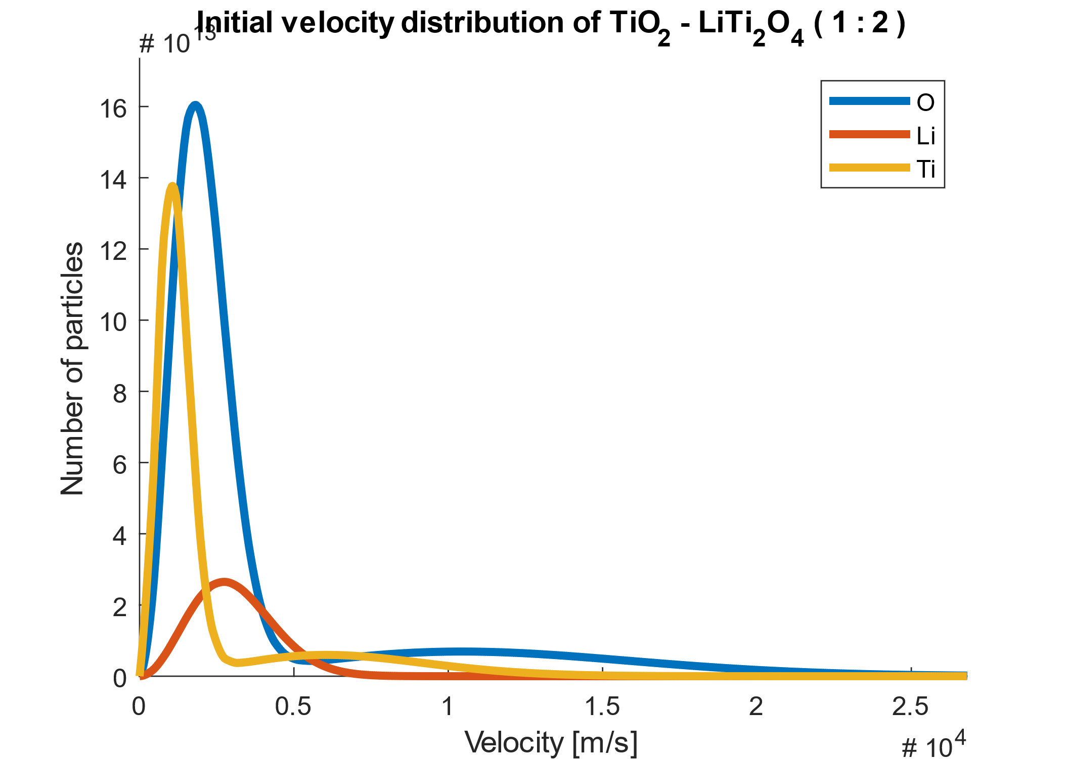
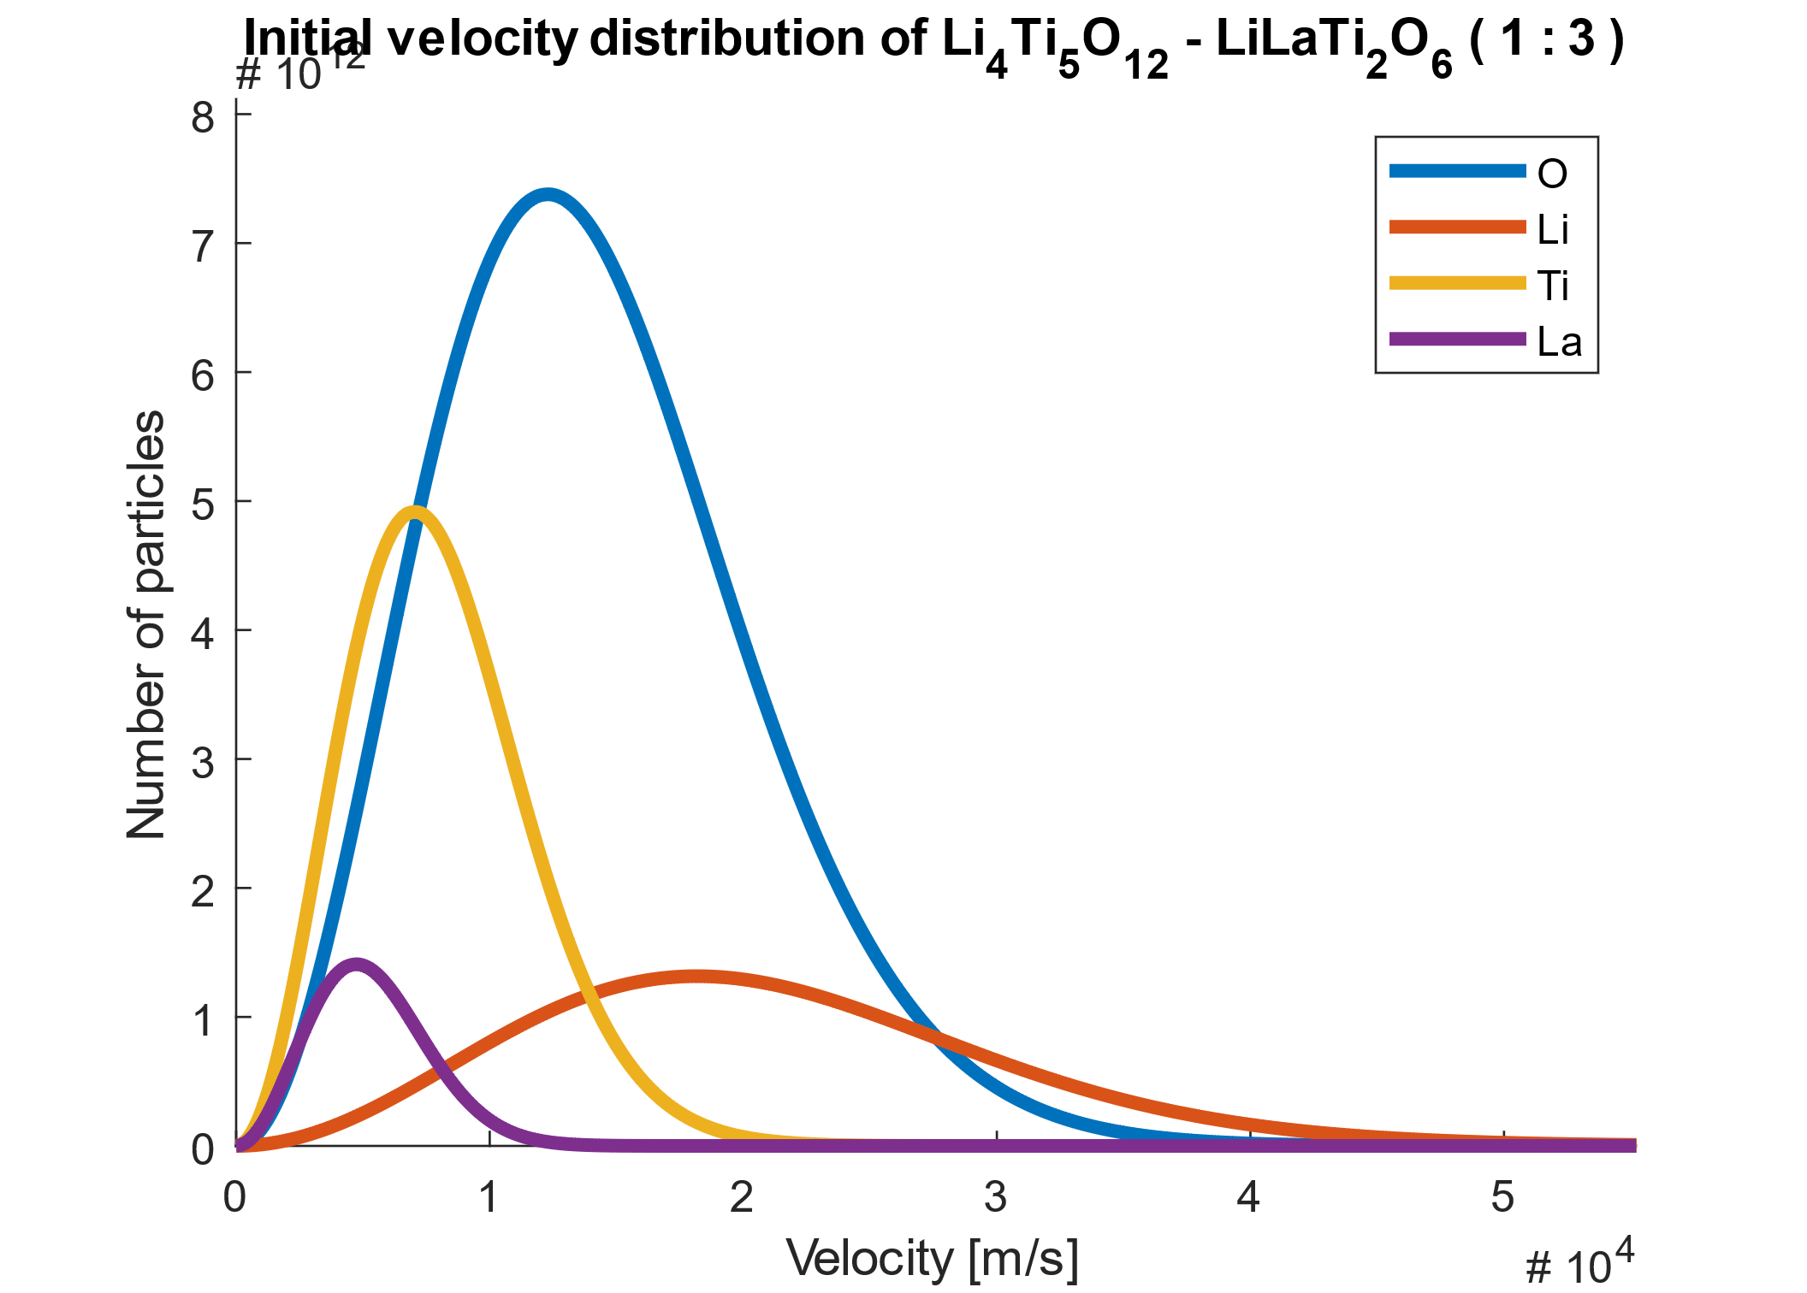
Results Initial velocity distribution

Slide 21
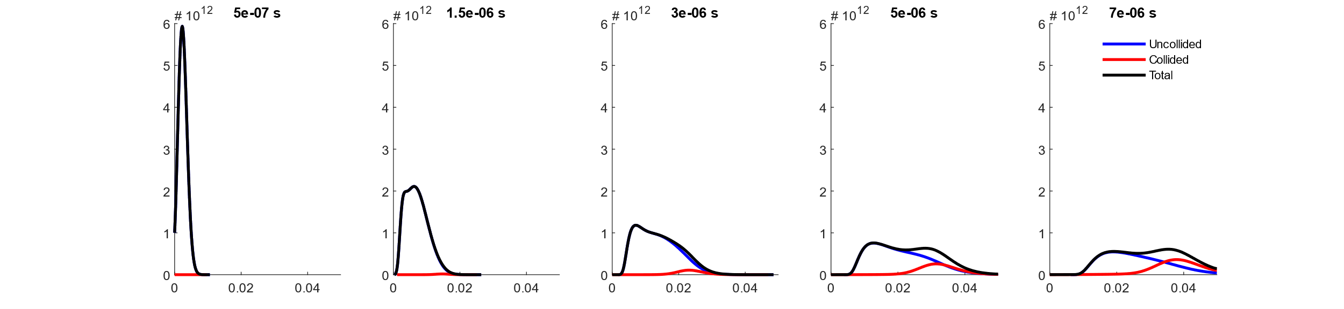
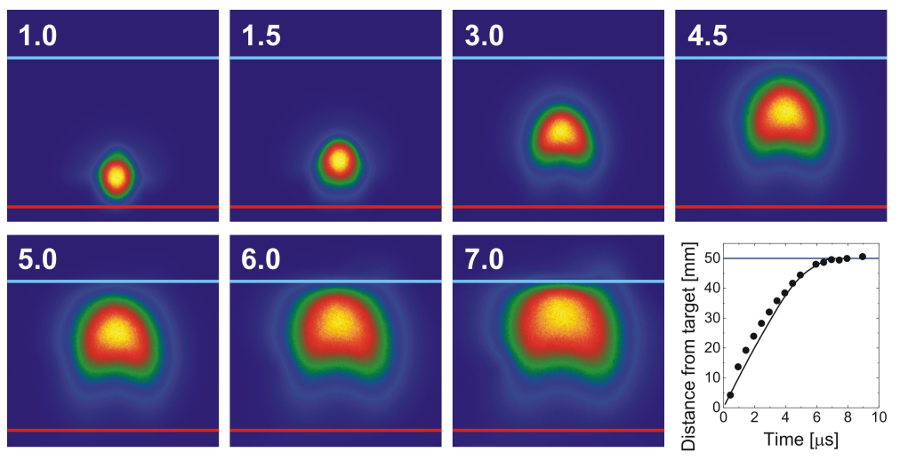
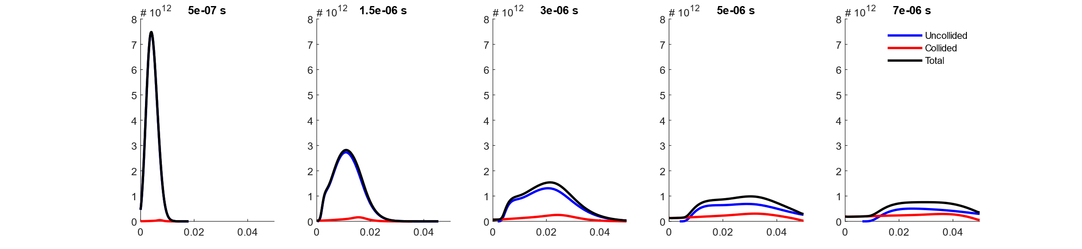
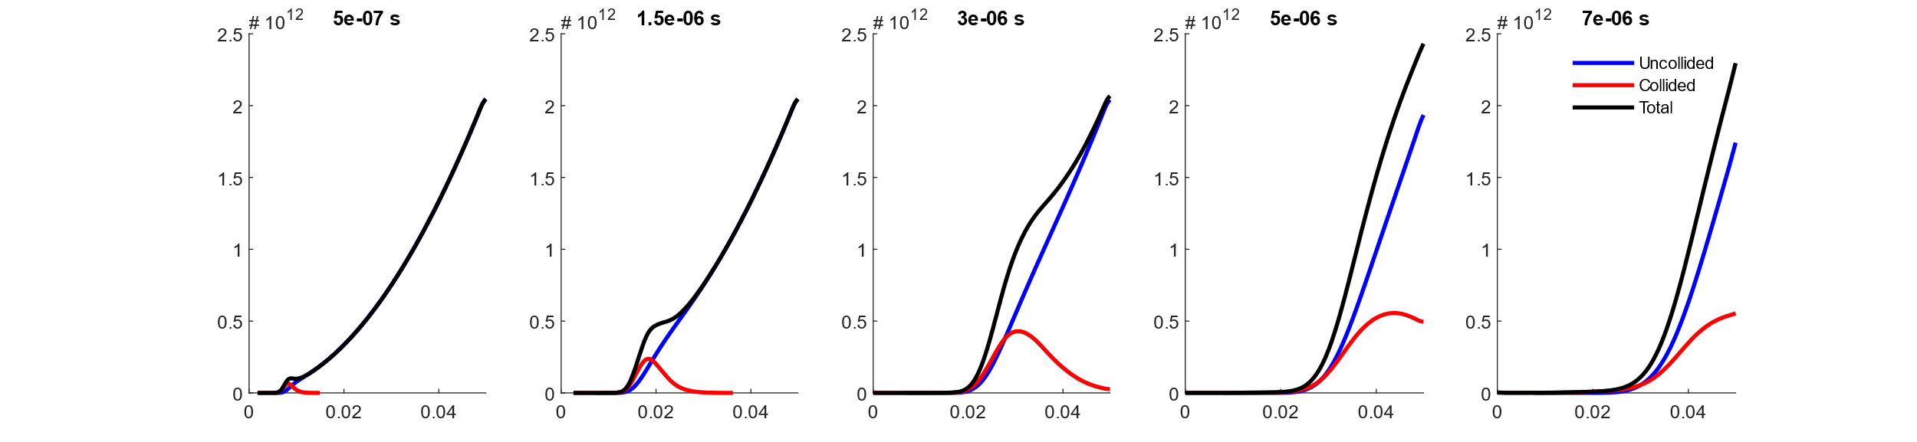
Results Plasma propagation – TiO2 at 0.02 mbar
Ti
O
Bg O2

Slide 22
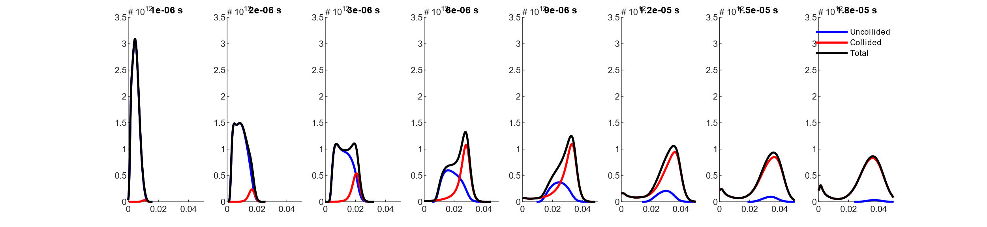
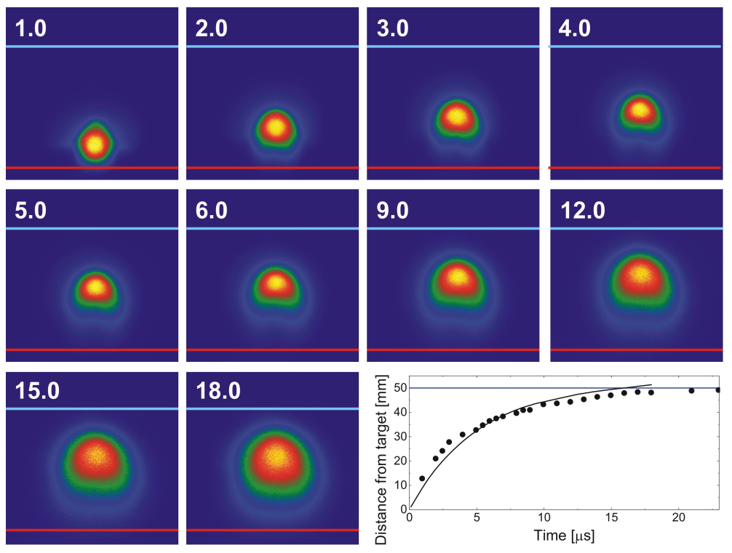
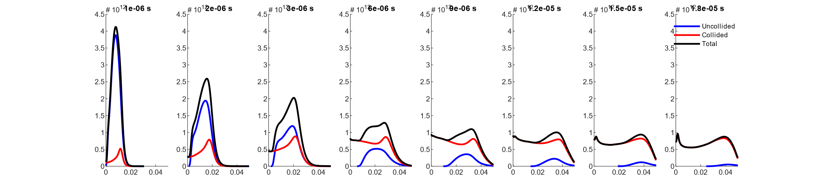
Results Plasma propagation – TiO2 at 0.1 mbar
Ti
O

Slide 23
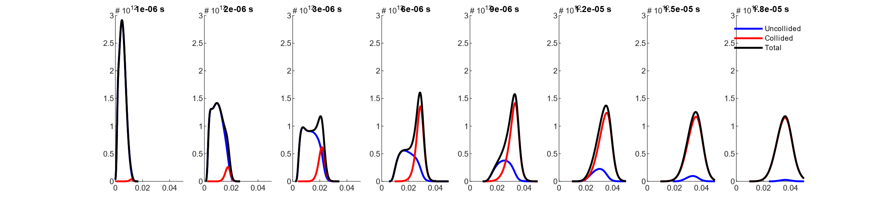
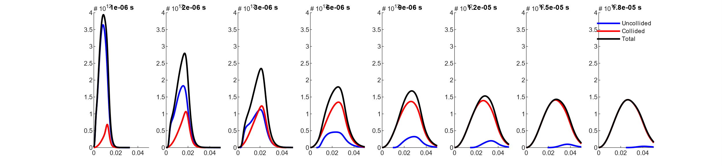
Results Plasma propagation – TiO2 at 0.1 mbar (no neg. velo.)
Ti
O

Slide 24
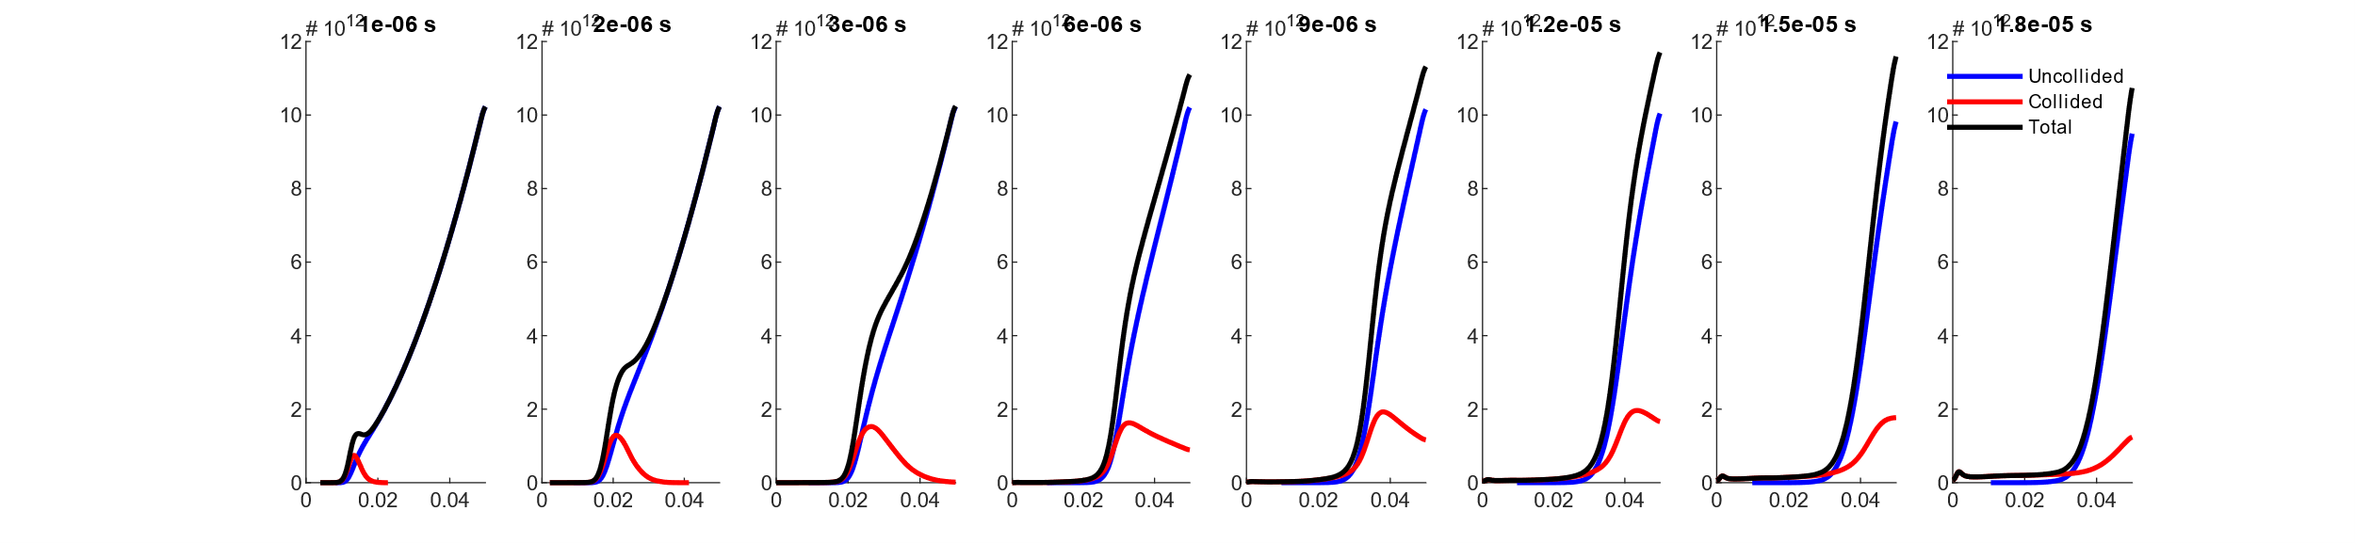
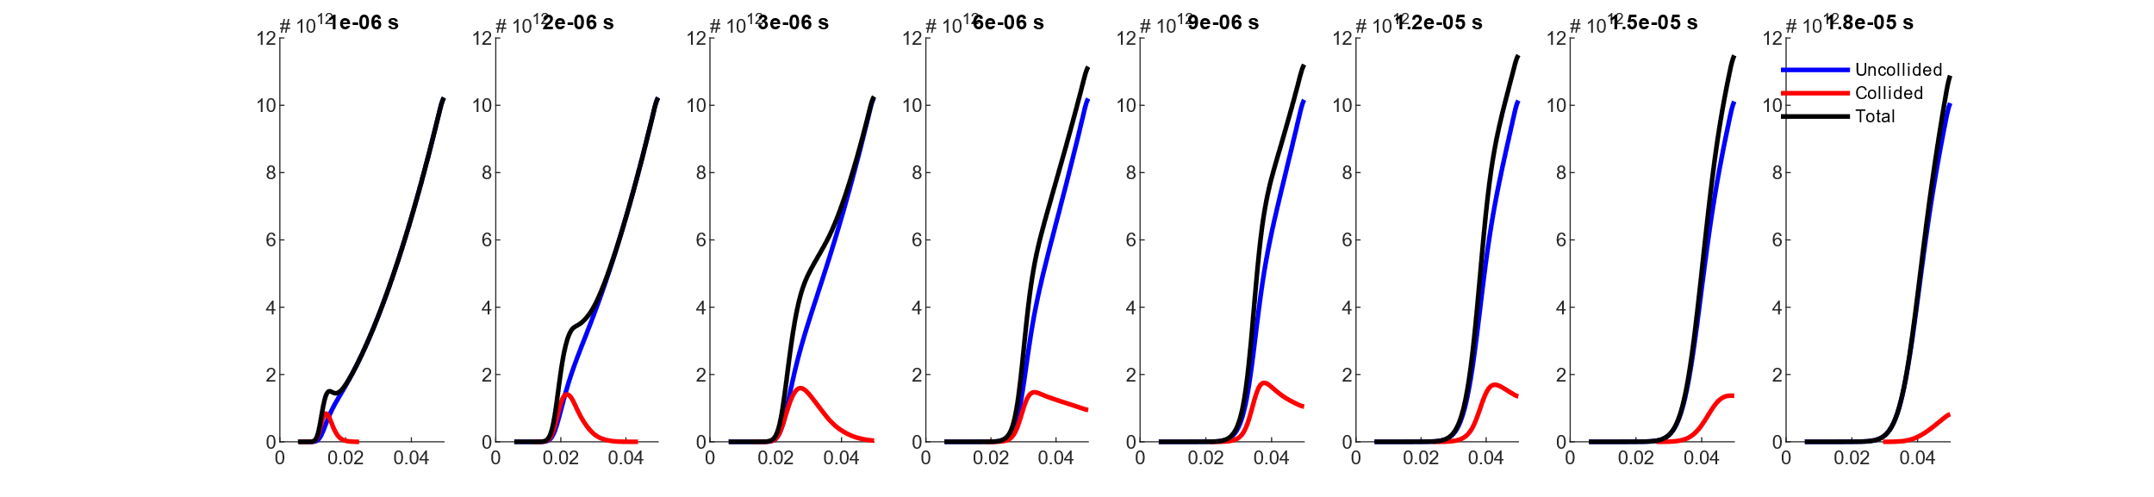
Results Plasma propagation – TiO2 at 0.1 mbar
Bg O2
Bg O2
(no neg. velo.)

Slide 25
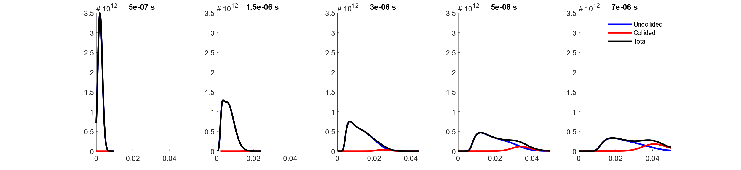
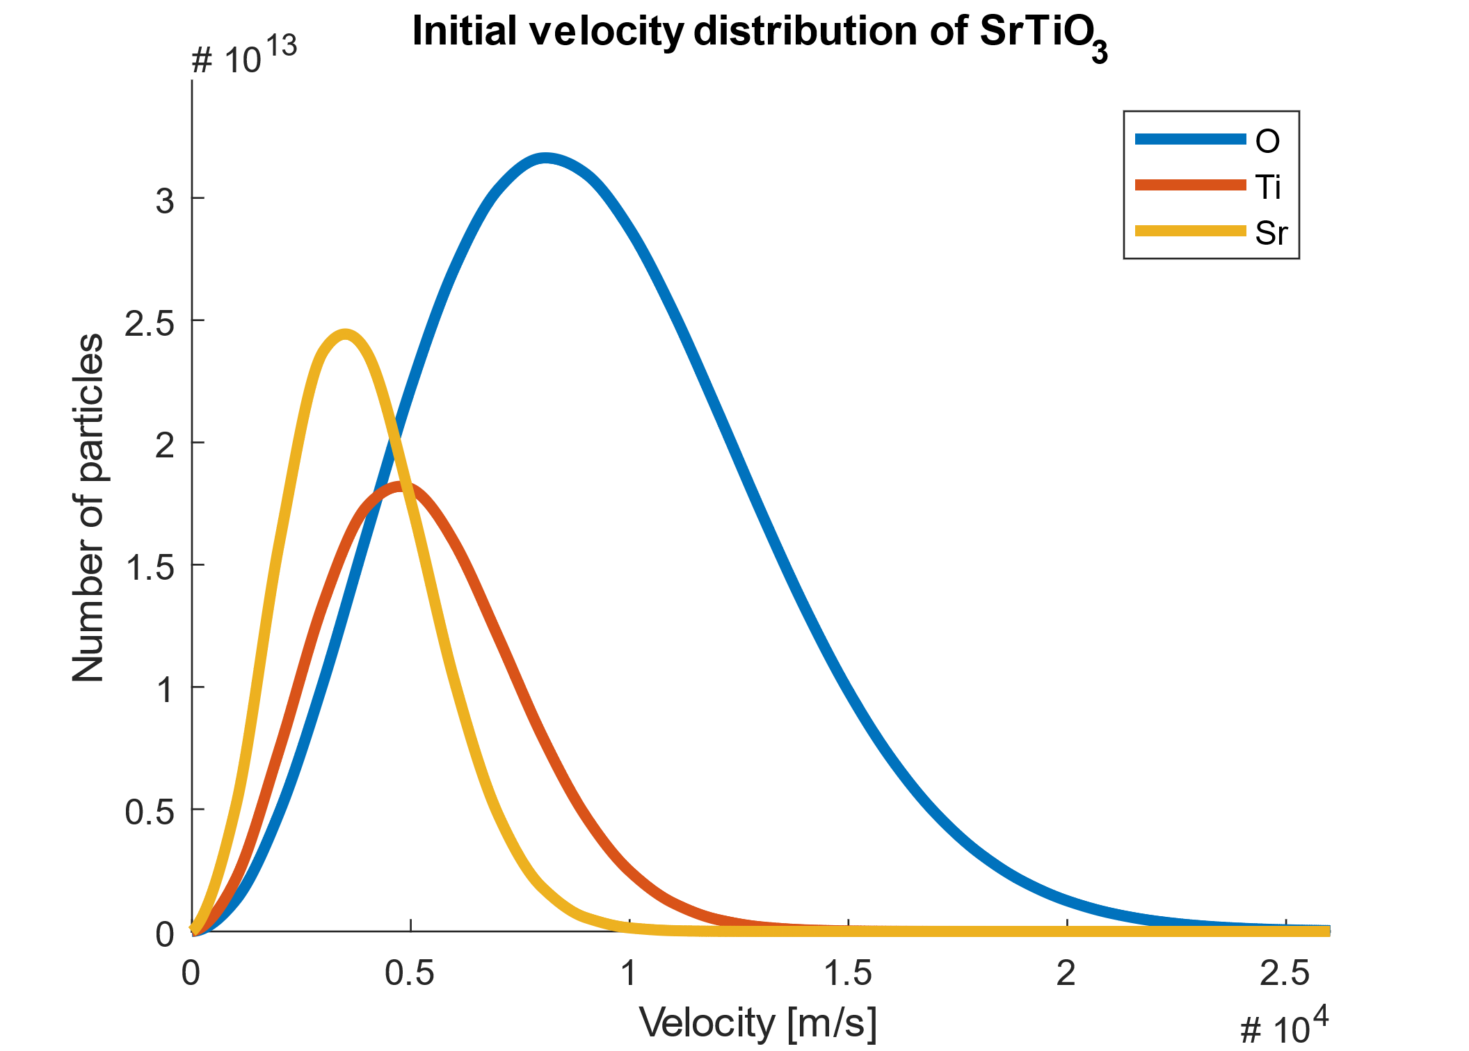
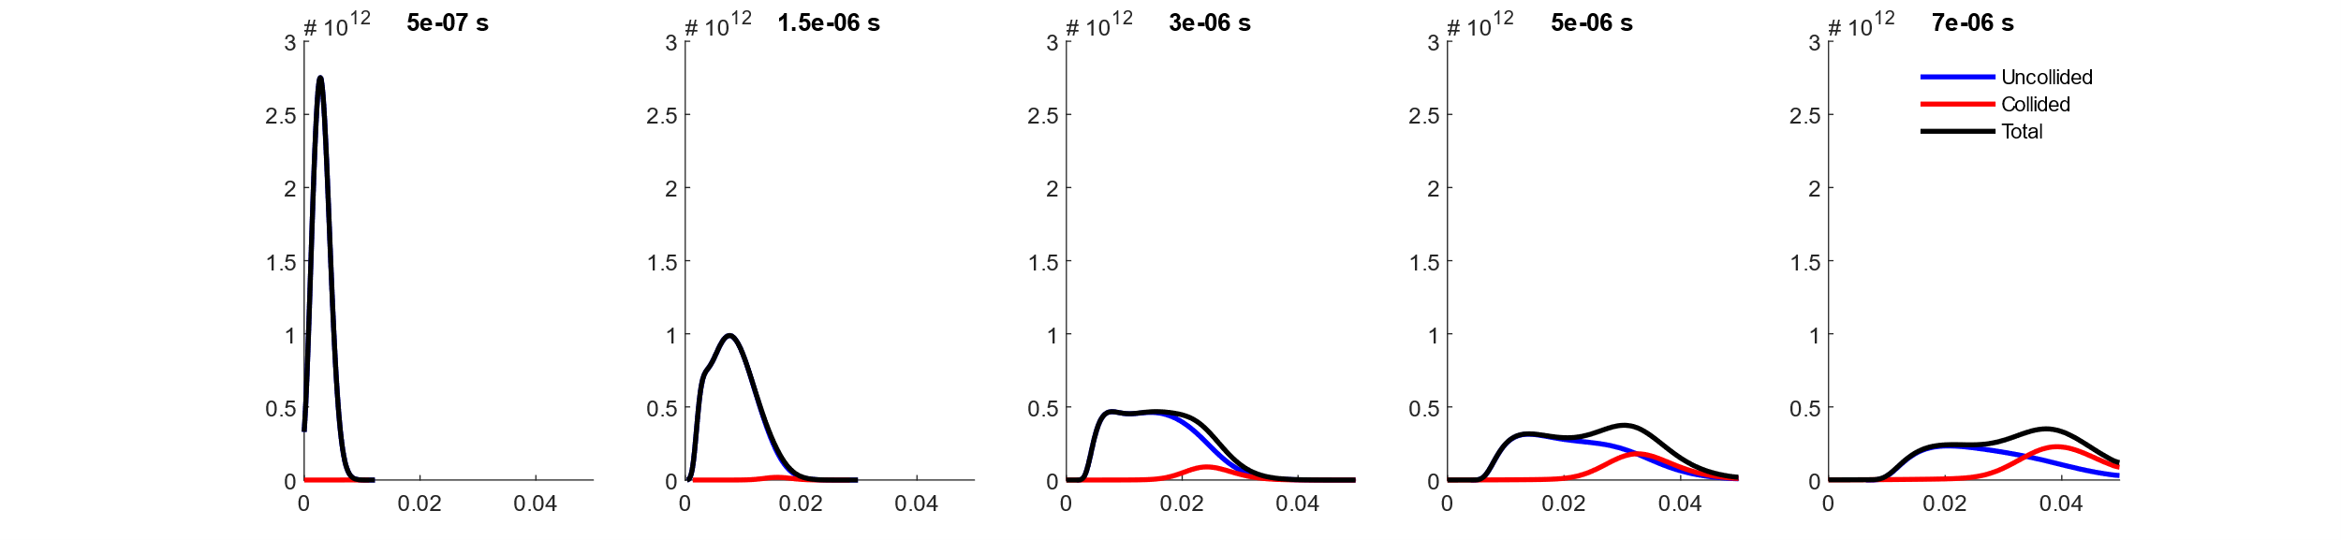
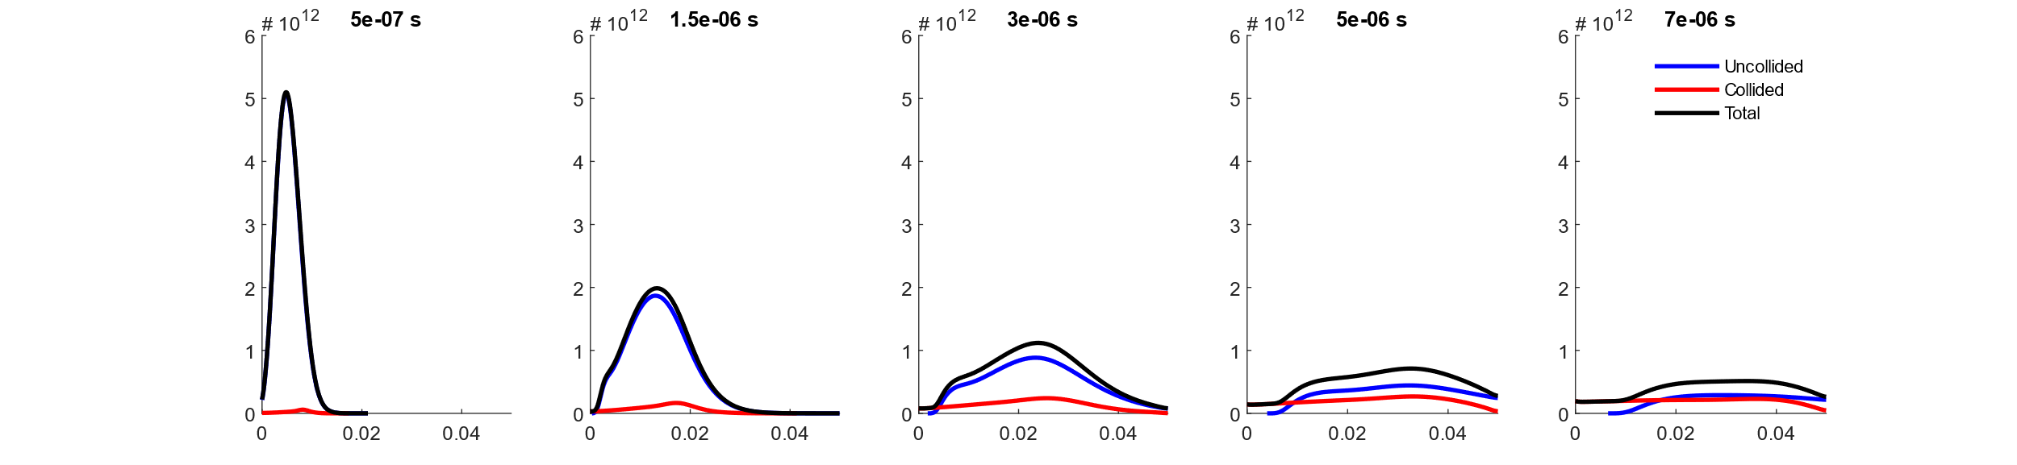
Results Plasma propagation – SrTiO3 at 0.02 mbar
Sr
Ti
O

Slide 26
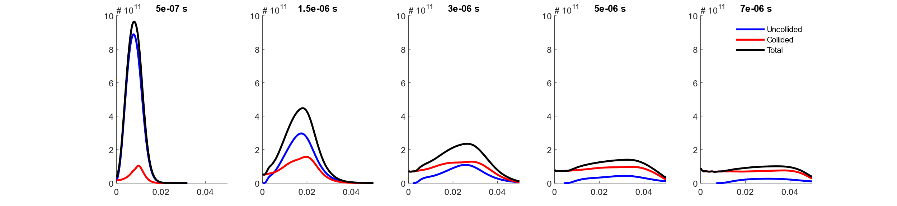
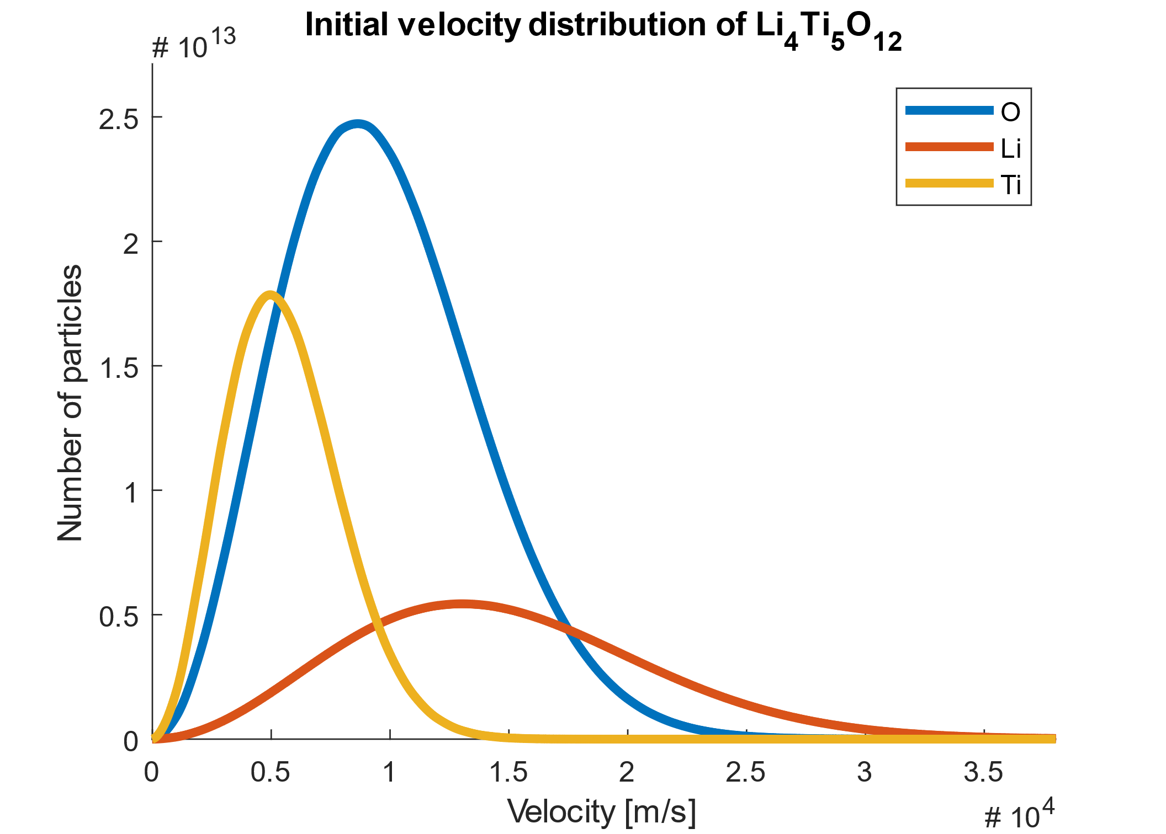

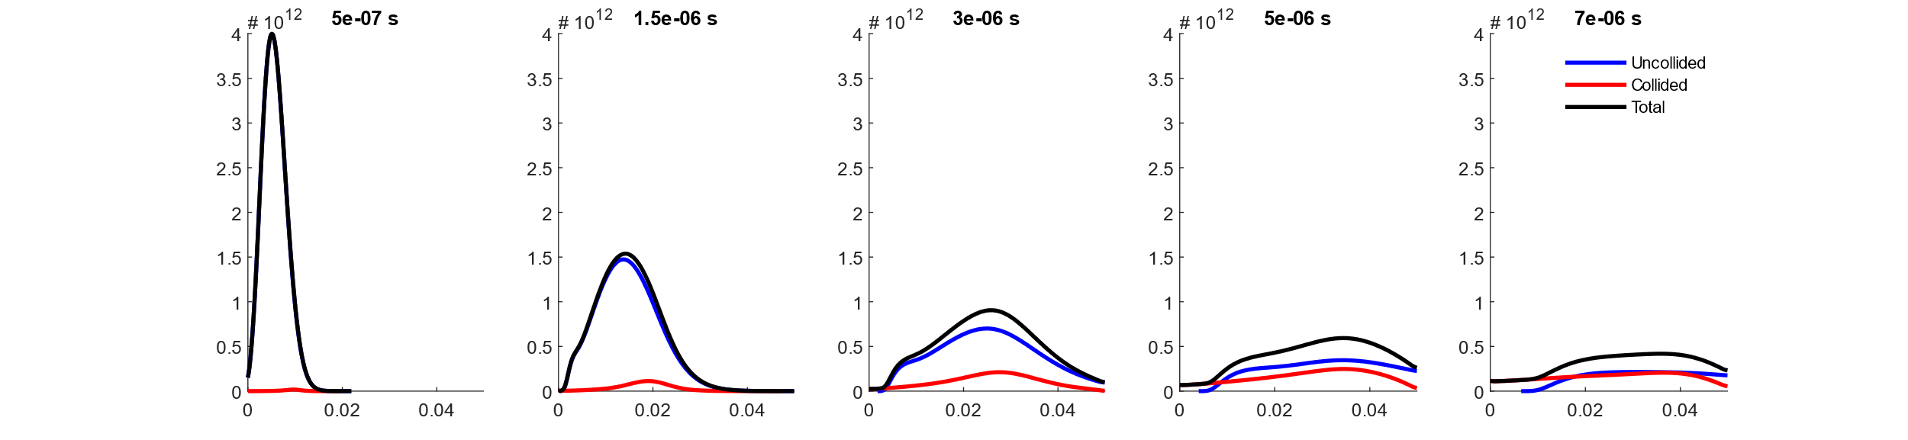
Results Plasma propagation – Li4Ti5O12 at 0.02 mbar
Li
Ti
O

Slide 27
Conclusions
The model does not exactly match measurement, but results are in a similar range.
The model delivers consistent results for different type of materials.
There seems to be an error for particle moving with a negative velocity, visible at higher pressures
Improvements
Fully modeled background gas particle kinematics
Support of any target composition, even mixture targets
Conservation of number of particles is ensured
Code is dynamic, self-documenting, and contains no ‘magic’ variables
Features missing
Oxidation of plasma species (although data structure supports it)
2D plume expansion plots

Slide 28
Suggestions
Introduce a temperature gradient in the background gas based on the substrate temperature
Find approximations for the heat dissipation into target and excitation energy of atoms
Include relation between laser fluence and spot dimensions and the angular distribution of particles
Allow highly kinetic particles to reflect of substrate surface and change direction
Implement MaterialsProject API to get material properties straight from their database
Add as material property which oxides a specific atom can form
Implement collisions between plasma species !

Slide 29
Proposal for collisions between all particles model
Loop through particle speeds
Loop through particle directions (towards substrate or towards target)
Loop through plasma species (and additional oxidized species)
Loop through filled radial bins
Calculate projected path the particle would travel without collisions
Calculate the number of collisions with every species and for all radial bins in the projected path (for all slower moving particles) simultaneously using matrix calculations
Calculate new velocities and positions after collision
Limit number of collisions by the total number of particles available
Remove particles from velocity and position before collision
Update all non-collided particle positions
Add back the collided particles to their new velocity and position after collision

Slide 30
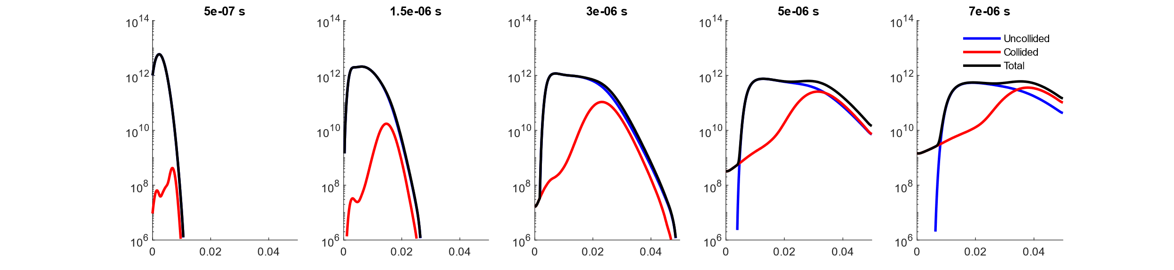
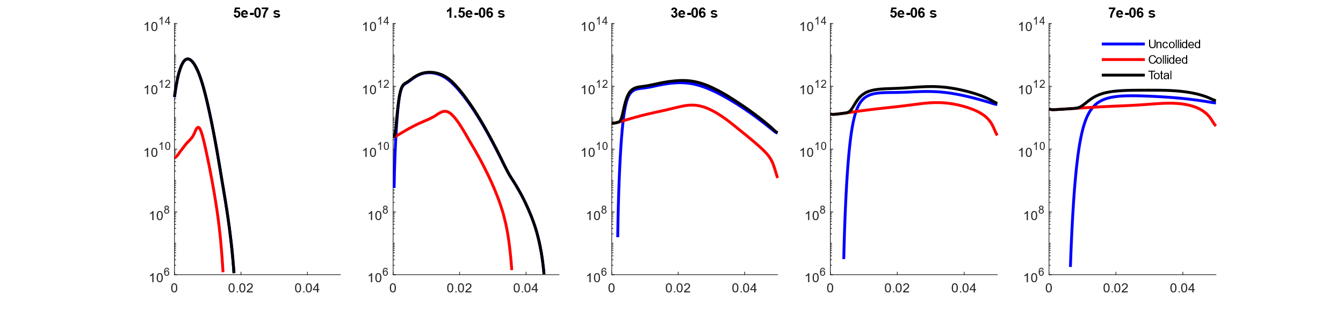
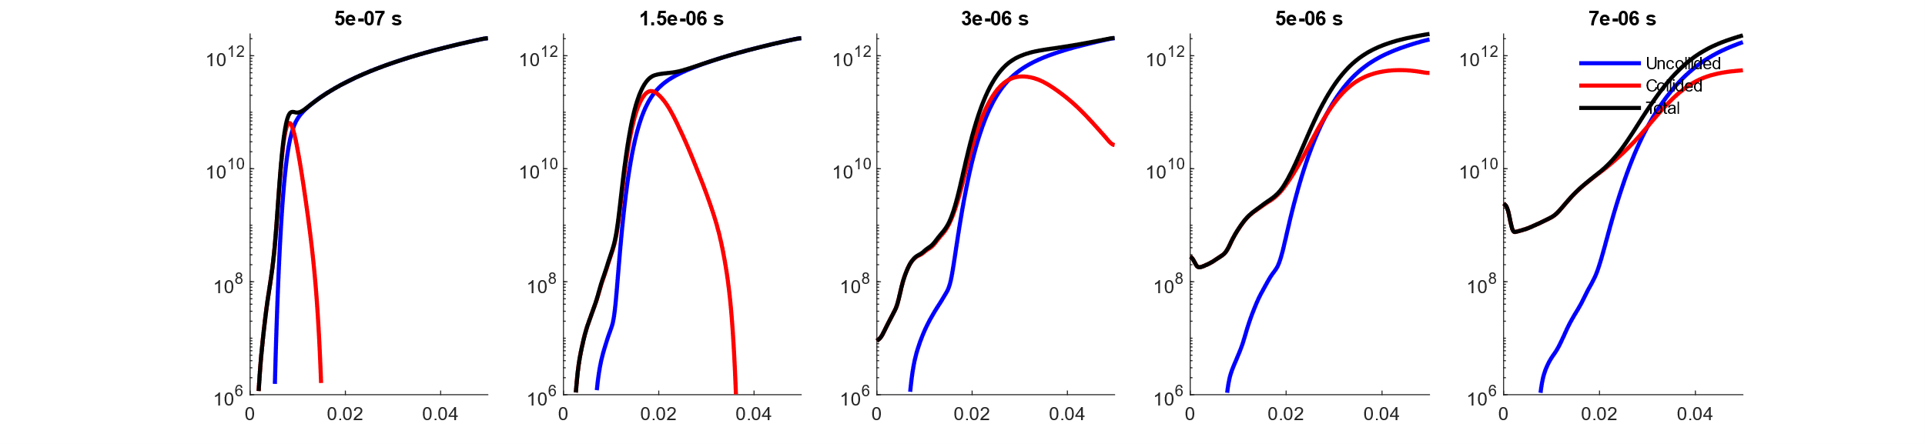
Results Plasma propagation – TiO2 at 0.02 mbar (log)
Ti
O
Bg O2

Slide 31
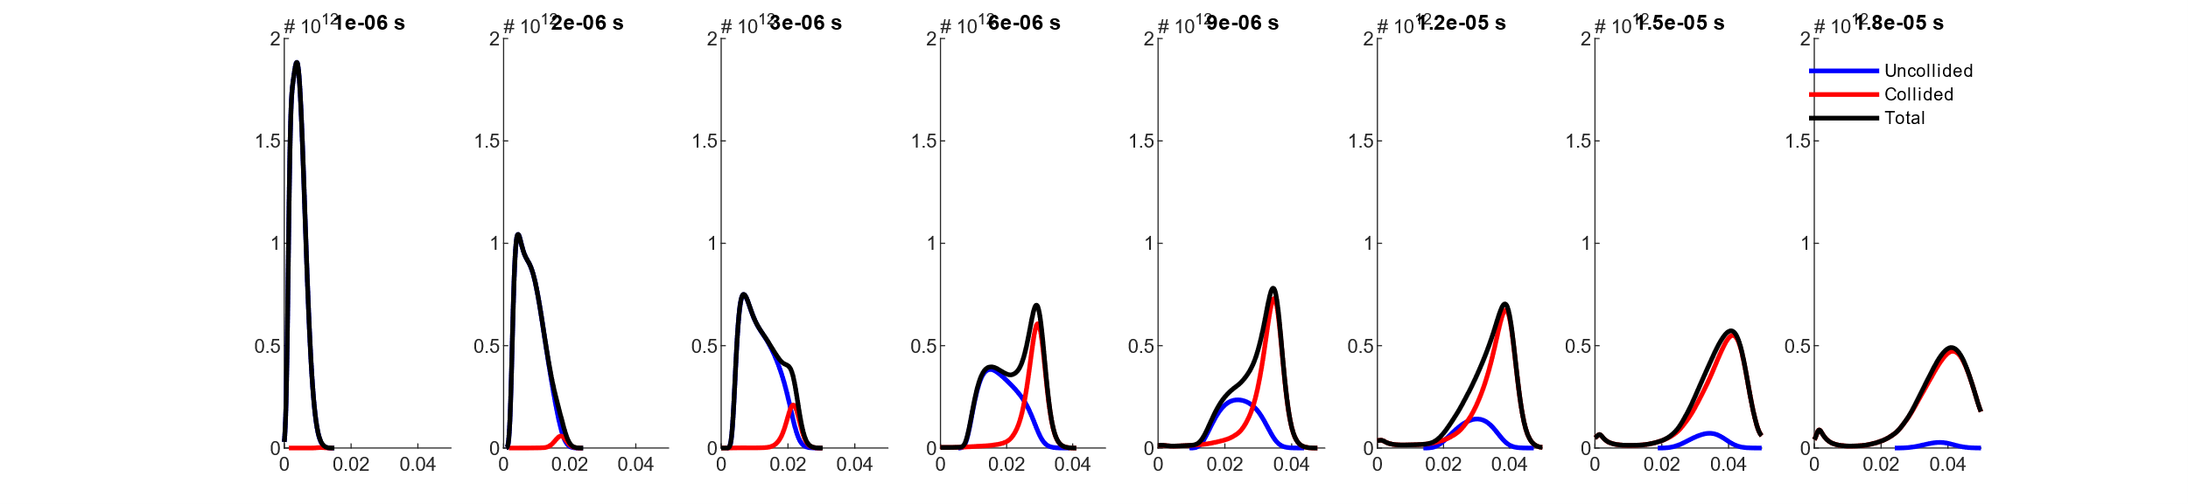
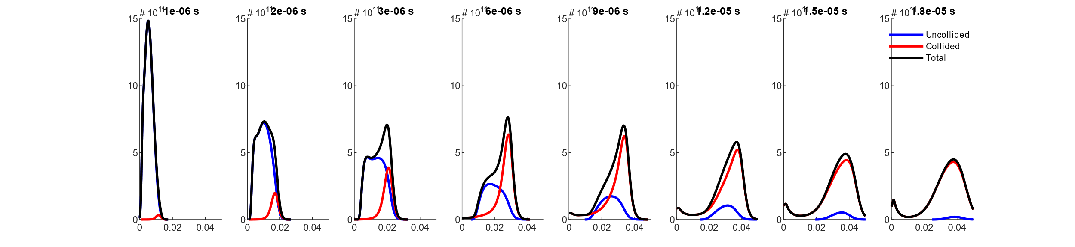
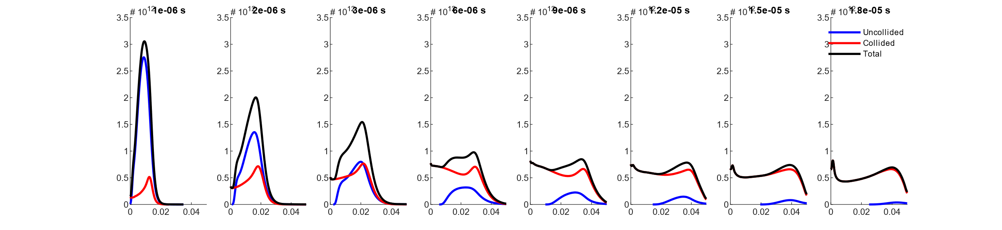
Results Plasma propagation – SrTiO3 at 0.1 mbar
Sr
Ti
O

Slide 32
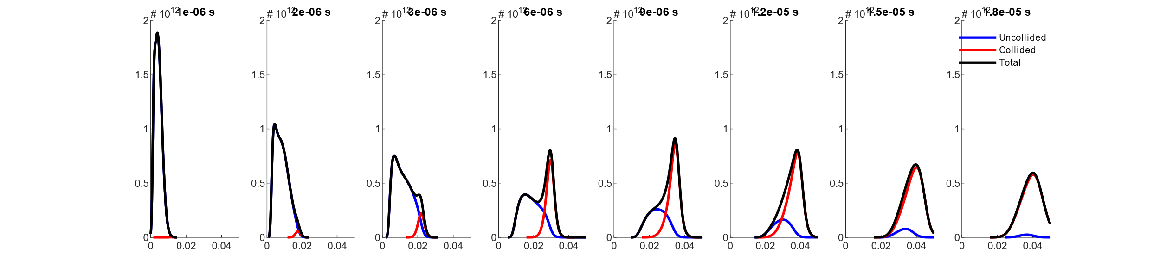
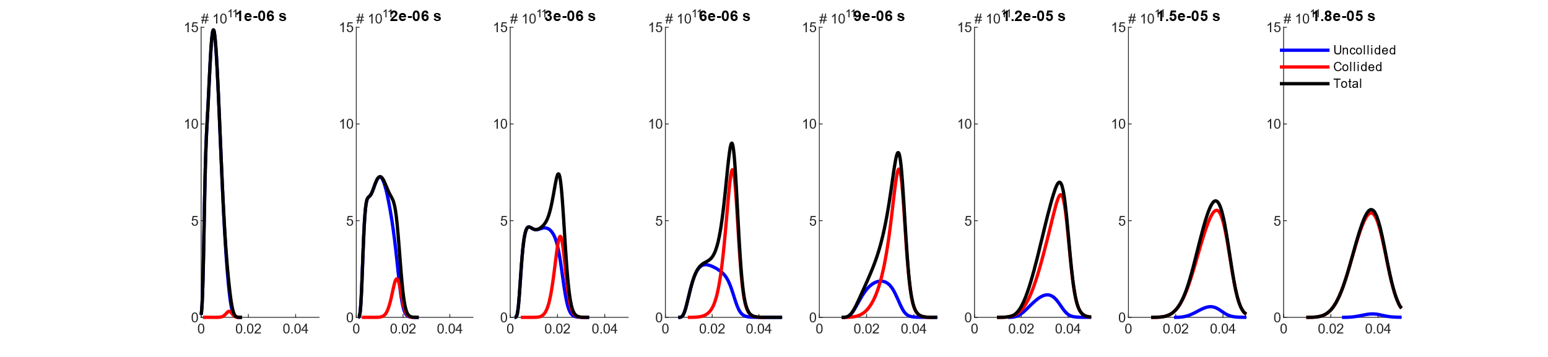
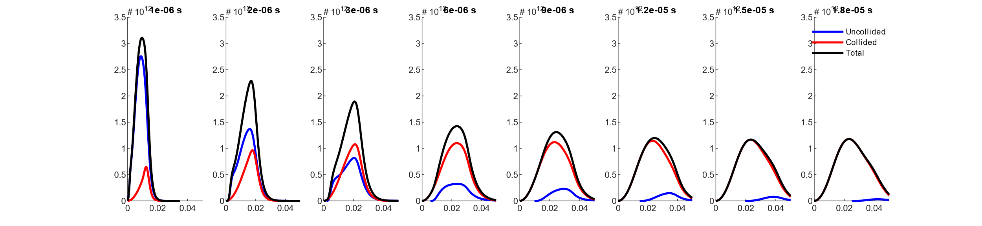
Results Plasma propagation – SrTiO3 at 0.1 mbar
Sr
Ti
O
No negative velocities allowed

Slide 33
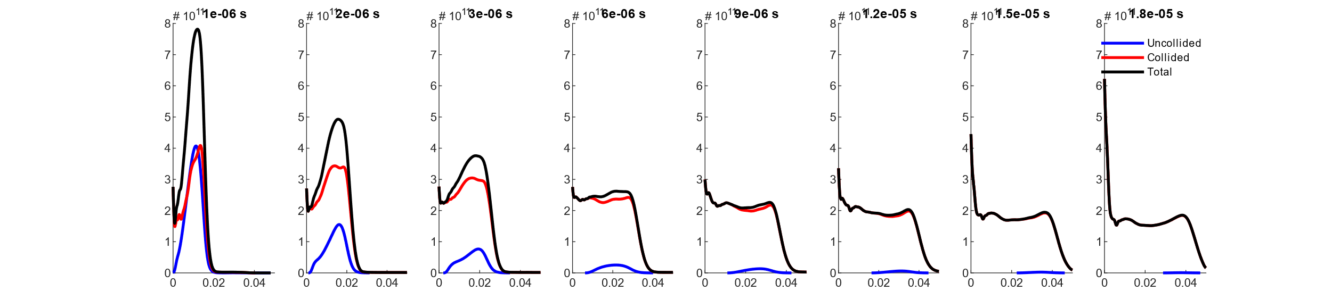


Results Plasma propagation – Li4Ti5O12 at 0.1 mbar
Li
Ti
O

Slide 34



Results Plasma propagation – Li4Ti5O12 at 0.1 mbar
Li
Ti
O
No negative velocities allowed

